Slide 1
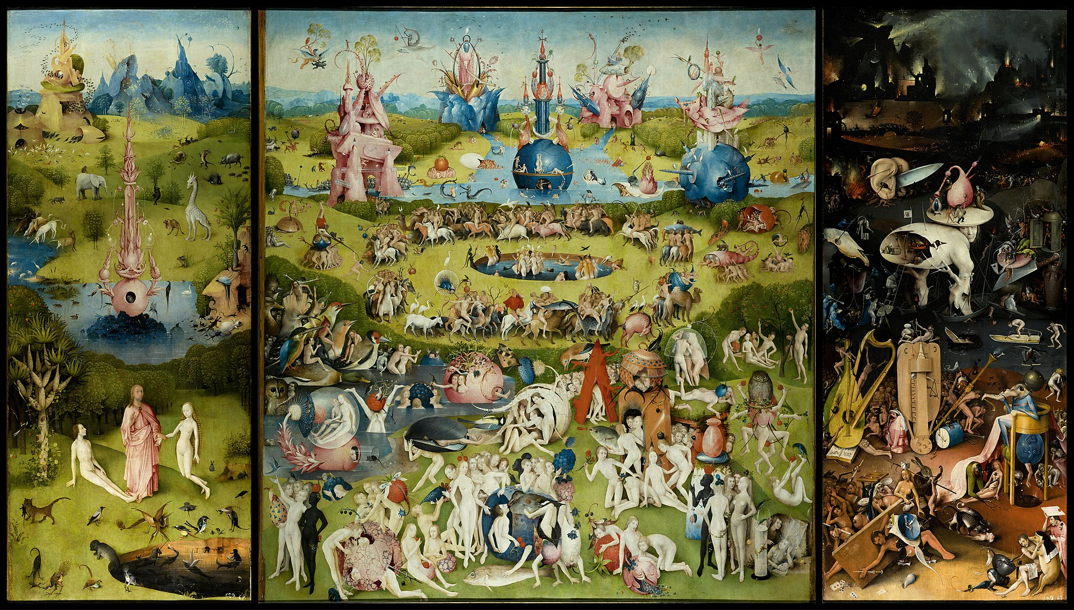
III. Interpretation, communication

Slide 2

References
Fundamentals of data visualization: https://clauswilke.com/dataviz/index.html
  It’s just great
E. Tufte, The Visual Display of Quantitative Information
  Old book from the 80s. It’s foundational and nice to skim through, but you won’t find anything groundbreaking due to its age.
Storytelling with data, Knaflic
Better data visualisations, Schwabish
Interpretable Machine Learning, Molnar
  https://christophm.github.io/interpretable-ml-book/

Slide 3




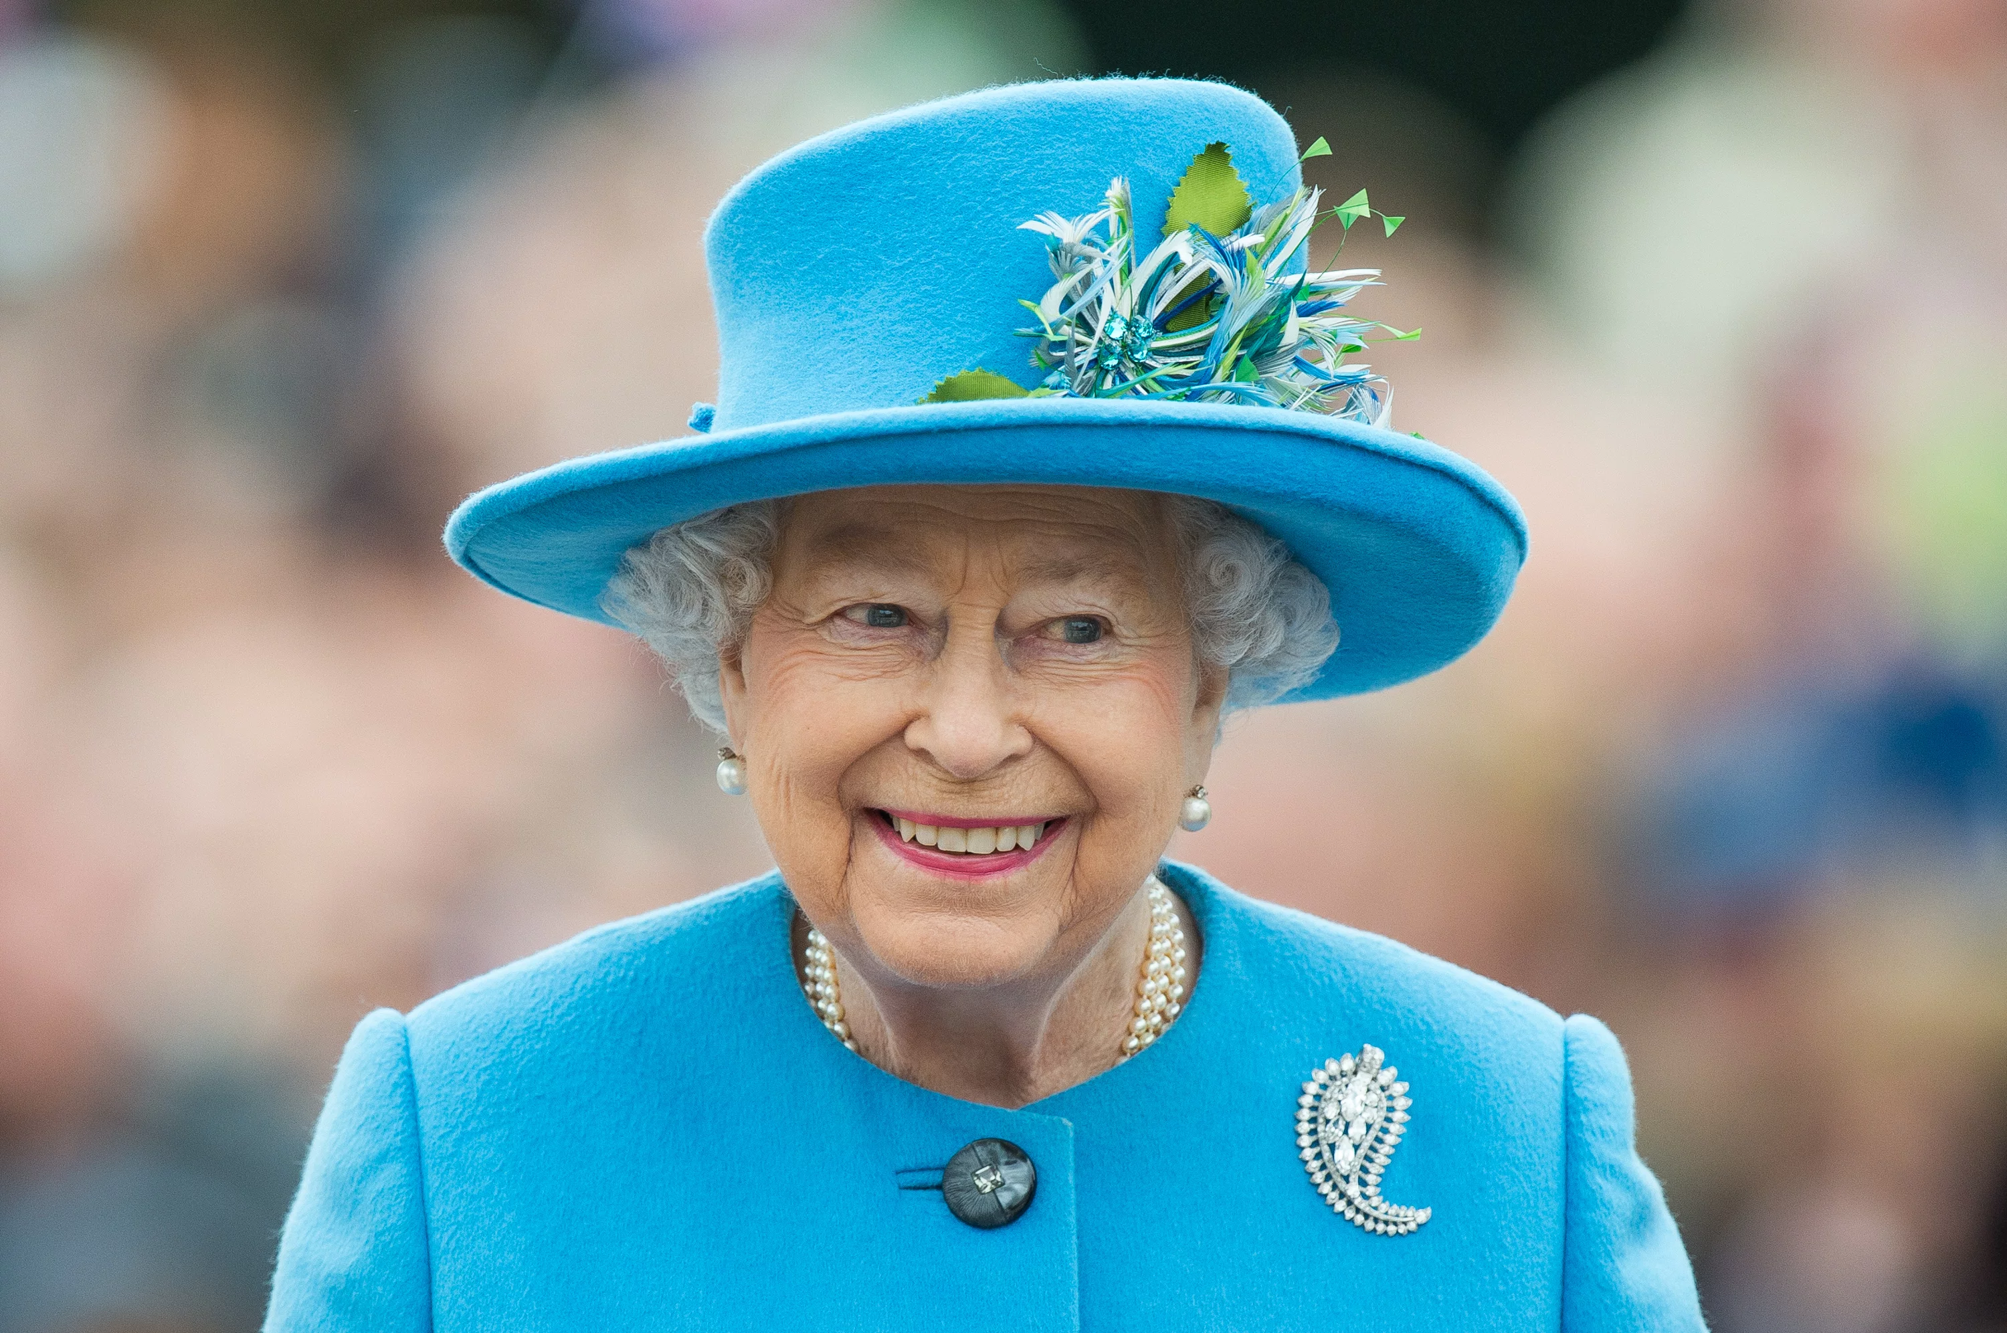
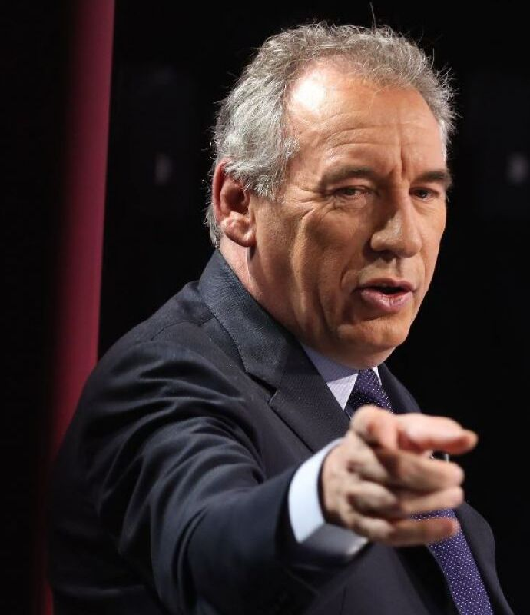
Decision makers
Their smiles are fake: they’re thinking you cost way too much
Ultimately, this will be your audience at some point: these can be clients, your boss, a bigshot, a director…
Know them: what they expect (or what they hope to hear), their level of technical expertise, their level of authority, the barriers they face…
  Whole lot of human parameters to take into account whenever you show important results
Don’t worry: most people are nice and things will usually go well
  But not always

Slide 4

Story time with a decision maker
I work on infants vaccination: their vaccination coverage, how long they take to get vaccinated, etc.
  Currently, infants have to be vaccinated against 11 diseases in France
Recently, I’ve focused on measles
  It’s one of the most infectious diseases currently (R0 between 10-30)
  It should have disappeared decades ago
  But it is so infectious that we should have vaccination coverages of >95% with two doses of the vaccine, and currently we are at around 86%
Currently, because of this, we have frequent measles outbreaks in Europe
  In 2023: 60 000 cases, 13 deaths

Slide 5
Measles
Measles is no joke:
  This leads to hospitalization (in 2023, around half of children with measles were hospitalised)
  It can lead to severe complications: pneumonia, encephalitis, or more long-term complications
  Worst case: you will have to explain to parents why their kid died of a disease that could have been prevented with a vaccine
We have two problems:
  Not enough infants get vaccinated (full vaccination coverage is at around 86%)
  Also, they get vaccinated too late: average delay of 7 months among infants who get vaccinated late (more than enough time for the disease to spread)

Slide 6
So what do we do?
Where I work, we analyse the current treads in health indicators in the region, and guide/help decision makers to improve the situation
  An intervention idea was to implement motivational interviewing about vaccines in maternities
  This has a positive effect on vaccine hesitancy, a key factor in vaccination refusal or delays
  We already did this, it works, and we wanted to implement this at a larger scale
  Our findings about vaccination delays and insufficient vaccination coverage would strongly support our case
We had to meet important people at the regional level to talk about this programme

Slide 7

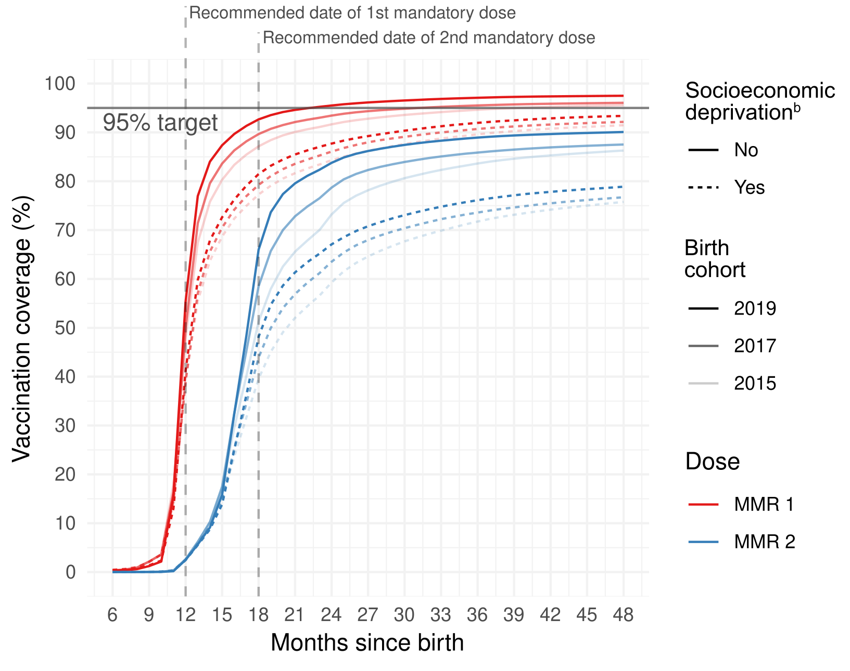

Meetings that go wrong
In a nutshell, it did not lead anywhere
Some outcomes will be out of your control:
  Some people have a priori beliefs and just want the data to confirm it
  Barriers that you do not know about: costs, politics…
  Resistance to change
  (Un)founded doubts about your analyses…
“Nah.”

Slide 8

The most difficult part of the job
Data science is actually a pretty chill job (most of the time)
  Coding is relaxing
  It is not always client facing
  It is quite solitary
Then comes the part when you must communicate your results to someone who needs to take on action based on your findings
  This is the most difficult because you deal with human beings who are (also) prone to bias and to misinterpret what you say
  This is also the most critical part of your work, because you can be the most talented Data Scientist, your work is useless if nobody understands what you do

Slide 9
Frustration, pt. 2
It is another barrier to take into account in your work (on top of all the problems you encounter)
You may be working on a project for months, only for it to:
  Be shut down by someone above you
  Change everyday due to lack of proper planning and focus
  Lack of interest by stakeholders
  Not yield any meaningful results
I have worked on reports which I suspect have never been read
  Data scientist is not a bullshit job, but you are likely to have bullshit tasks

Slide 10
How not to mess it up
LEARN HOW TO
COMMUNICATE

Slide 11
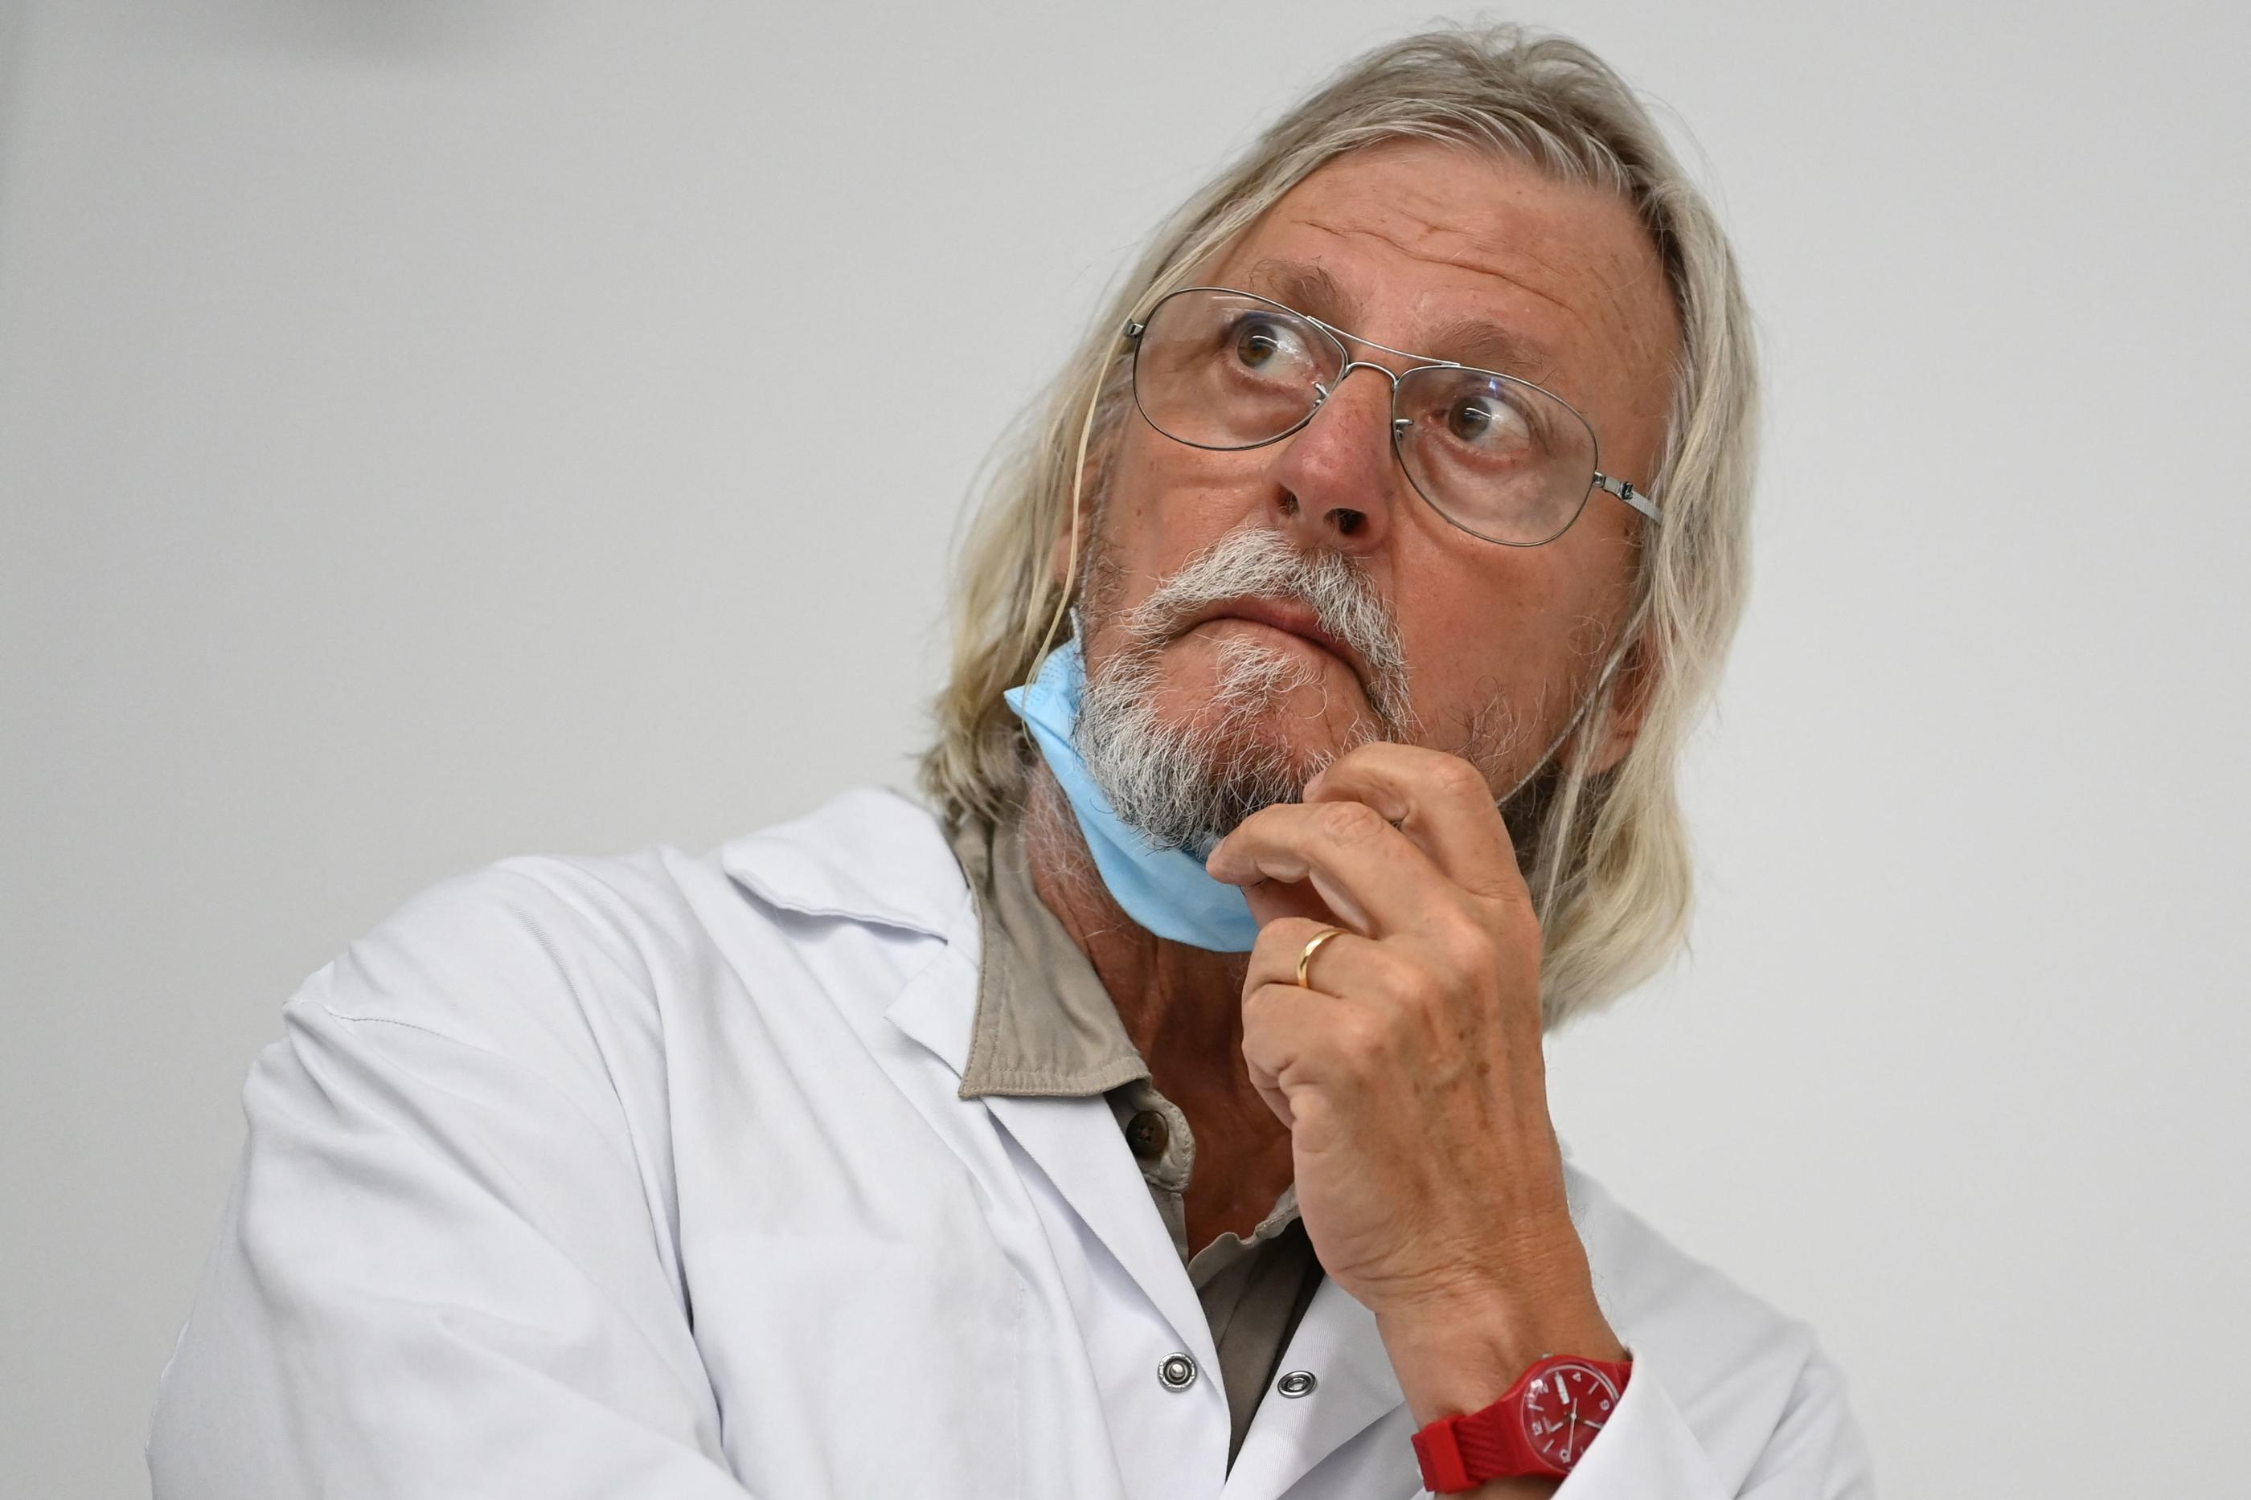
Communication dynamics (1)
Simplifying (or vulgarizing) is a core skill, because there is a change of dynamic
As a student, some authority figure (e.g. me) gives you technical knowledge
  Vocabulary is often technical jargon, which is shared between both
As a professional, this is reversed:
  You are the authority figure (people expect you to know what you are doing)
  Vocabulary is not expected to be technical jargon
Be aware you can be an authority figure and still spout utter nonsense
Notes:
Authority figure: maybe not at first, but you will quickly become one
Also, told you this already, but don’t market yourself as a « graduate ». Consider yourself more of a working, fully capable professional. You know how to do data science already (you got a degree in that, you know.)

Slide 12

Communication dynamics (2)
This may seem obvious, but people don’t understand complicated stats
So, are you able to explain in layman terms what is:
  A logistic regression?
  Clustering?
  A dimensionality reduction technique (like PCA, MCA…)?
  A p-value?
Notes:
You are not aware how reliant you are on concepts you take for granted or don’t fully understand yourself
I’m pretty sure not a lot of you can explain these concepts clearly. Not that you don’t understand them
I got asked in a interview once to explain a logistic regression in layman terms.

Slide 13
My take on vulgarising
Not that easy, and not something you are expected to be able to do, but you will have to do it constantly and on the fly.
Fully understand your concept and strip away technicalities, jargon, parts that require prior specialized knowledge to understand
Identify your audience: their level of expertise and what they need to know
Set your concept in a relatable or intuitive example
Explain the core purpose of the concept
Slowly add details (this will depend on your audience, and what you need them to understand for your presentation)
Generalise
Notes:
Easier for some than others, it depends on how you are used to learn things. Some prefer to simplify complicated concepts to learn them: they will be better at this exercise.

Slide 14
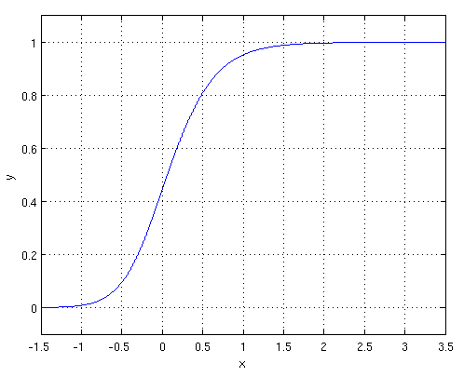
How I vulgarise (1)
How I would tackle explaining logistic regression in a typical meeting in which I show regression results:
[Example/problem] Let’s say you want to know if there is a link between smoking, your occupation and lung cancer.
[Purpose] A logistic regression can tell you how more likely you are to get lung cancer depending on the job that you do and if you are a smoker
[Details] It’s a model that will compute a probability of getting lung cancer given these factors, based on the data. You can calculate coefficients that will tell you, for example, how much this probability increases when you smoke.
[Generalise] This type of tool allow you to estimate the probability of some event happening depending on factors of your choosing
Notes:
[Details] The details you can change on the fly depending on who you are talking to, and if you need them to need

Slide 15
How I vulgarise (2)
If it’s not a crucial concept, I just stick to a one sentence explanation to give the general purpose of the tool in the context of my presentation:
Example: I’m giving a presentation on unvaccinated children
[Purpose] “A logistic regression can tell you how more likely an infant is to not be vaccinated depending on some factors, for example here: its birth year, socioeconomic status, and number of visits to the paediatrician”

Slide 16
Preparation time
Before doing anything, you’ll answer the questions:
  Who is my audience?
  What would I like them to know?
  How do I transmit them this information?
“Who”: narrow your target audience and your relationship to them
  Is it a decision maker? Your senior DS colleague? Students?
“What” will help you select:
  The data that is relevant to them and how detailed you will be
“How”:
  What medium you will use (graphs, tables, etc.) to transmit knowledge
Notes:
Keep in mind that most of the time people won’t be as knowledgeable as you about statistics.
If you don’t already know who you are going to present to, best way to save time is just to ask around about them (if you know people that know them).

Slide 17
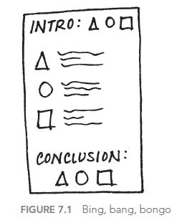
What structure for a presentation?
Set it up like a story (or an IMRaD structure if you work in a research-oriented field: introduction, methodology, results, discussion)
  Beginning: set up the setting, the problem to solve, who is impacted by this problem, what change there should be and your recommendation to solve it
  Middle: now you introduce your data to reinforce your point
    E.g further illustrate your problem, incorporate comparisons, examples,
    options and benefits of recommended solution…
  End: summarise everything, reiterate what should change and how
  to do it (“call to action”)
Essentially, repeating similar things at each step (in
Storytelling with Data, they call that “Bing, Bang, Bongo”)
works quite well. Repetition helps you nail your point.
Notes:
Keep in mind that most of the time people won’t be as knowledgeable as you about statistics.
If you don’t already know who you are going to present to, best way to save time is just to ask around about them (if you know people that know them).

Slide 18

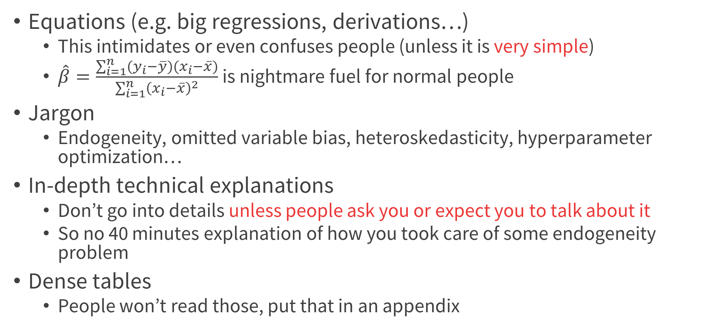
A shortlist of what to strongly avoid with non-technical people
Equations (e.g. big regressions, derivations…)
  This intimidates or even confuses people (unless it is very simple)
  $\hat{β}=\frac{\sum_{i=1}^{n}{(y_{i}−\overline{y})(x_{i}−\overline{x})}}{\sum_{i=1}^{n}{{\left(x_{i}−\overline{x}\right)}^{2}}}$ is nightmare fuel for normal people
Jargon
  Endogeneity, omitted variable bias, heteroskedasticity, hyperparameter optimization…
In-depth technical explanations
  Don’t go into details unless people ask you or expect you to talk about it
  So no 40 minutes explanation of how you took care of some endogeneity problem
Dense tables
  People won’t read those, put that in an appendix
Notes:
E.g. do they really need to know about all the subtleties of your microsimulation model?

Slide 19

A shortlist of what you should do with non-technical people
One-pagers/executive summaries
  In your introduction, you can start with your big results, actions you think should be taken, indicators to keep, etc. etc.
KISS (and other minimalist concepts)
  Keep It Simple Stupid
  Less is more
Put yourself in their shoes:
  What do you think they expect?
  Are they likely to understand what I say?
  Are there barriers that will make my communication not have the impact I would like?
Notes:
Your audience is often going to be non-technical people

Slide 20
Three principles to follow with your visualisations
Trustworthy
Make it reliable. Is your visualisation faithful to the data? Does the design have integrity?
Accessible
Make it usable. Is your visualization relevant and understandable?
Elegant
Make it aesthetic. Is your graphic design appealing?

Slide 21
Your tools
Preliminary point: data-to-ink ratio
Text
Descriptive tables
Graphs
Dashboards
Regressions/ML results + interpretation tools

Slide 22
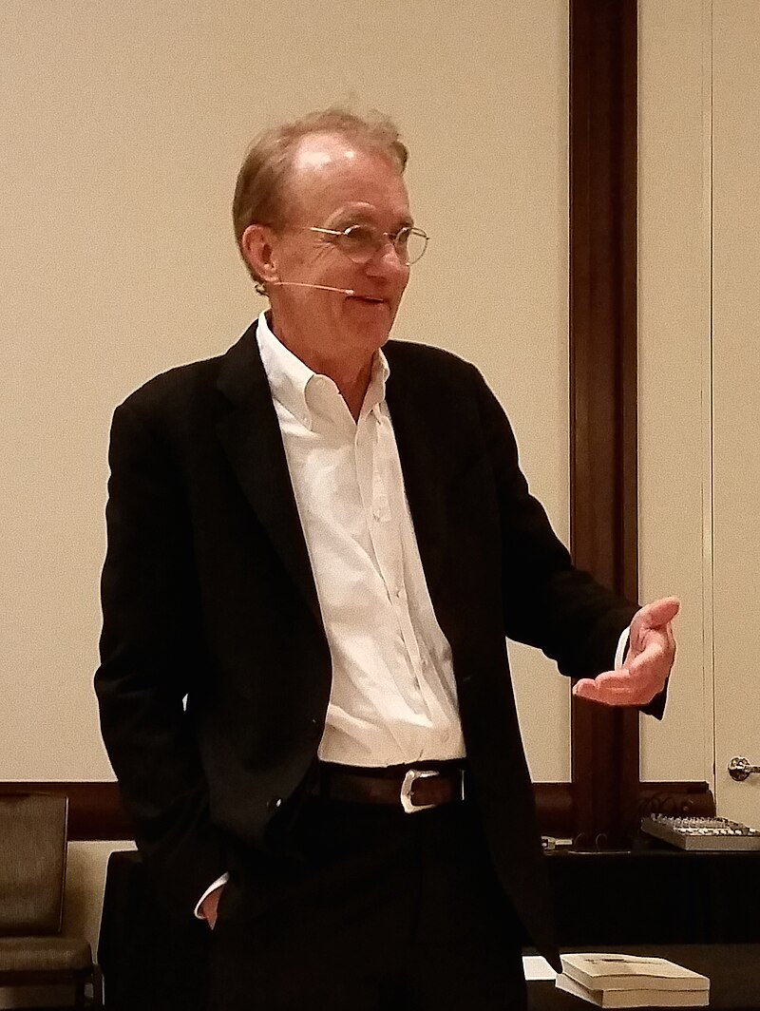
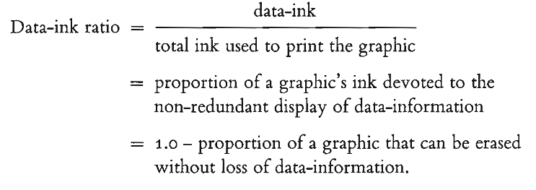
Data-to-ink ratio
Whatever your tool, you might want to maximise the data-to-ink
ratio (see E. Tufte, Visual Display of Quantitative Information)
“The larger the share of a graphic’s ink devoted to data, the
better (other relevant matters being equal).”
In a nutshell: identify and eliminate clutter
Notes:
This is an old concept from 40 yeas ago. It is more or less adopted now.

Slide 23
What’s clutter?
What’s wrong with it ?
Low data-to-ink ratio
Notes:
Ask students what they prefer

Slide 24
What’s clutter?
Quite data-to-ink ratio
Base Excel graph
Notes:
Ask students what they prefer

Slide 25
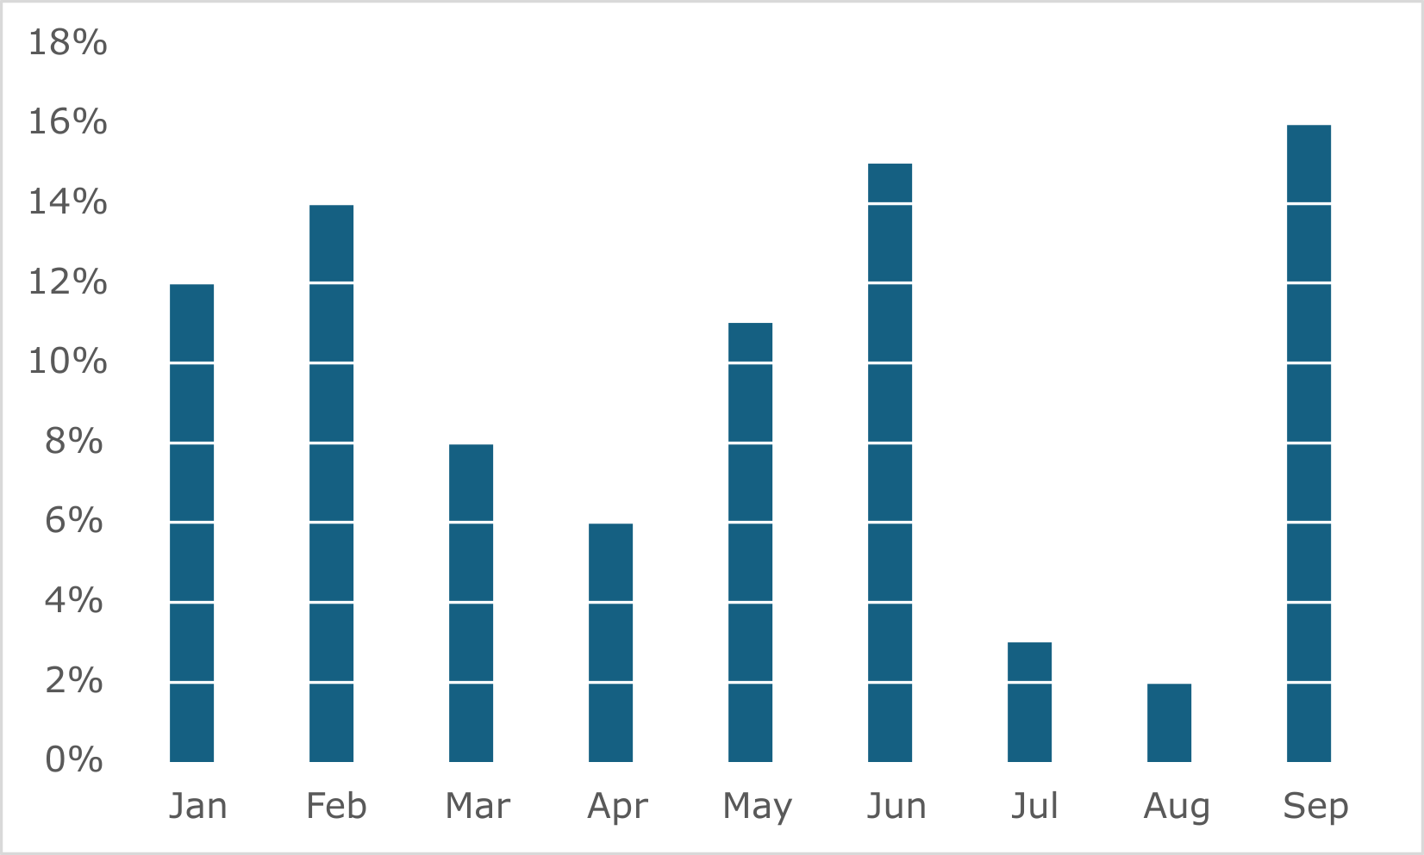
What’s clutter?
Very high data-to-ink ratio
Same
Notes:
Ask students what they prefer

Slide 26
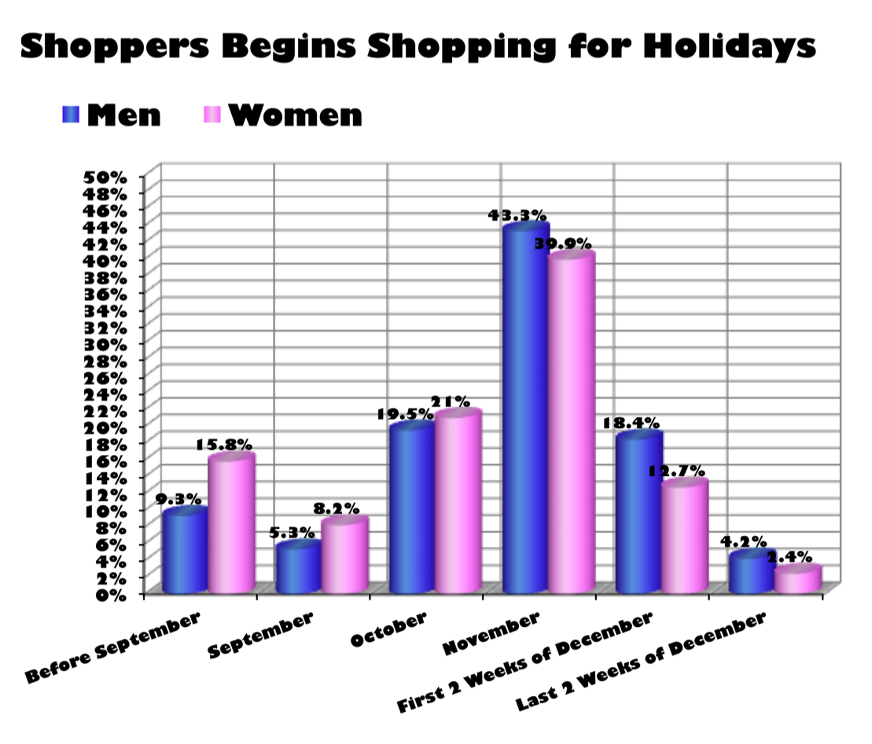
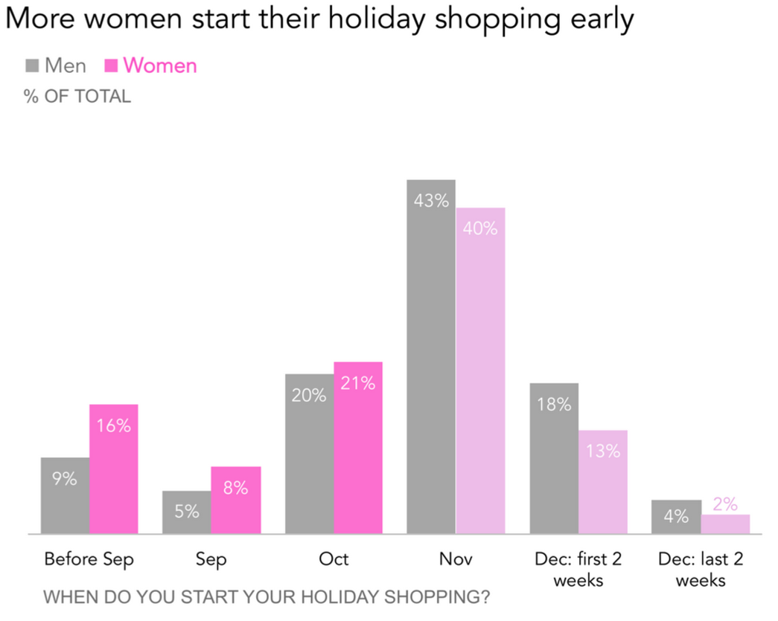
What’s clutter?
Notes:
What they got rid off: grid lines, y axis, shortened labels, decimals, ugly 3D, the visual effect on the bars, the font, used color highlights to attract attention, active title, grey/desaturated color where the author does not want us to look at, data labels in the bars in white, better harmonisation of font size, removed tick marks
Still things they can get rid of: lower border, the percentages

Slide 27
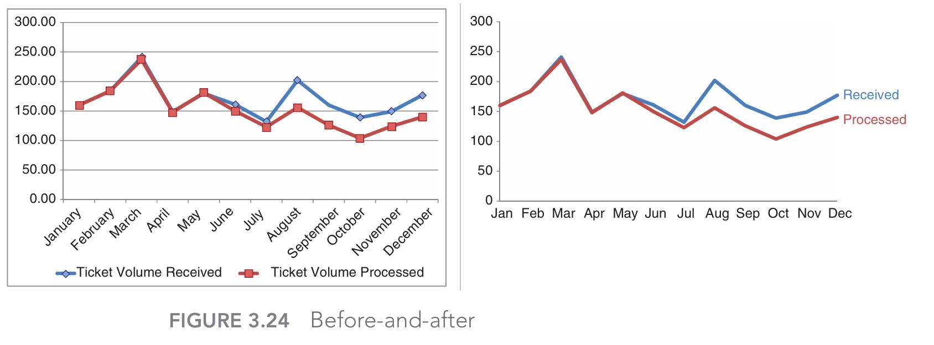
What’s clutter?
Low data-to-ink
High data-to-ink
Placing labels directly on the chart is a good way to make it more engaging

Slide 28
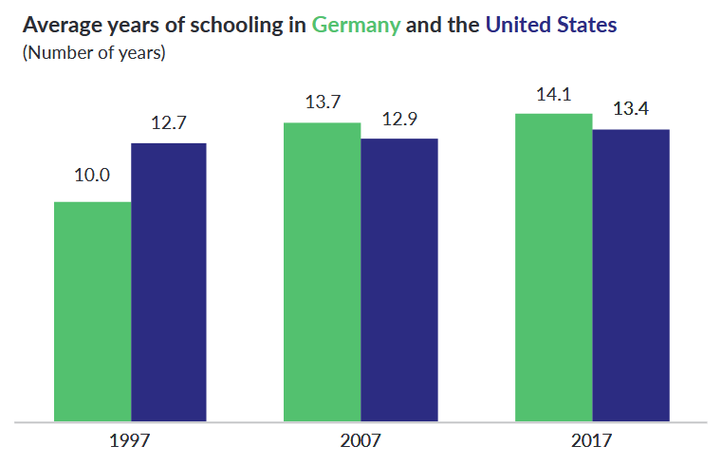
What’s clutter?
Or be more creative: remove labels, put them directly in the title

Slide 29
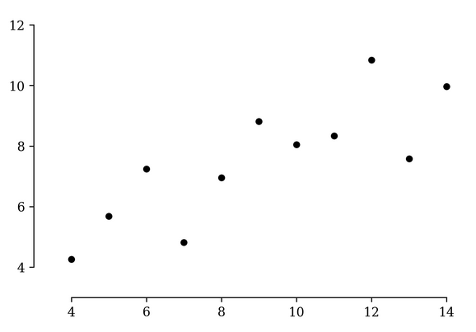
What’s clutter?
Notice the fancy trick of the range beginning/ending at the min/max

Slide 30
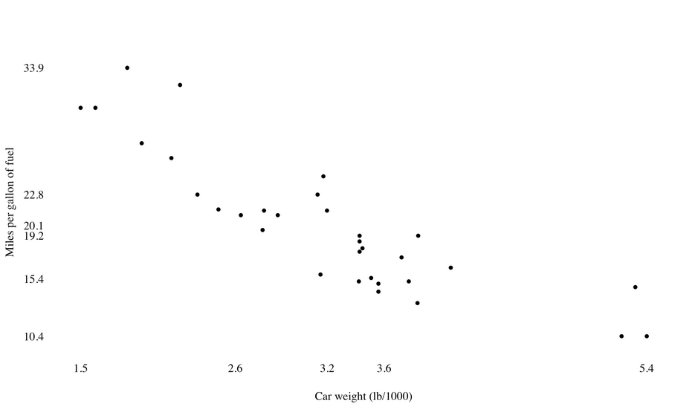
What’s clutter?
Here, the ticks are the quartiles. It’s hard to understand though.

Slide 31
Data-to-ink, my two cents
It does make your graphs look fancy and quite clear, but a too high data-to-ink ratio may not be to everyone’s tastes
  Ideally, you should aim for graphs styles that are the easiest to interpret
  Don’t mistakenly erase content that help with interpretability
People are not used to very high data-to-ink ratios
  People don’t like change: you should aim to use chart styles that people are familiar with (even if it is not optimal)
  However, you could progressively increase the ratio as people start to get used to it
This may require modifying your graphs by hand
  The best viz are done manually, on a graphic design software (Inkscape, Illustrator…), not directly on R

Slide 32
Your tools
Preliminary point: data-to-ink ratio
Text
Descriptive tables
Graphs
Dashboards
Regressions/ML results + interpretation tools

Slide 33
Text
Text alone don’t make a good data visualization tool (though there are text-based graphs)
But it is a good complement to graphics and tables

Slide 34
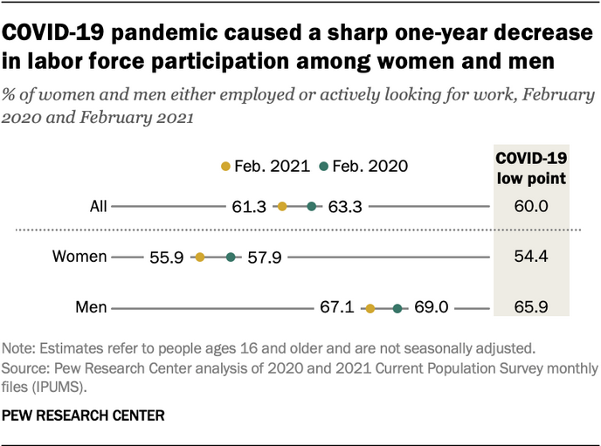
Active titles
Your title can be used to transmit a key message (instead of just describing the data)
Not everyone likes that though
Also: notice all text are properly aligned
  This is a detail
  But attention to detail makes the difference between a good graph and a great graph

Slide 35
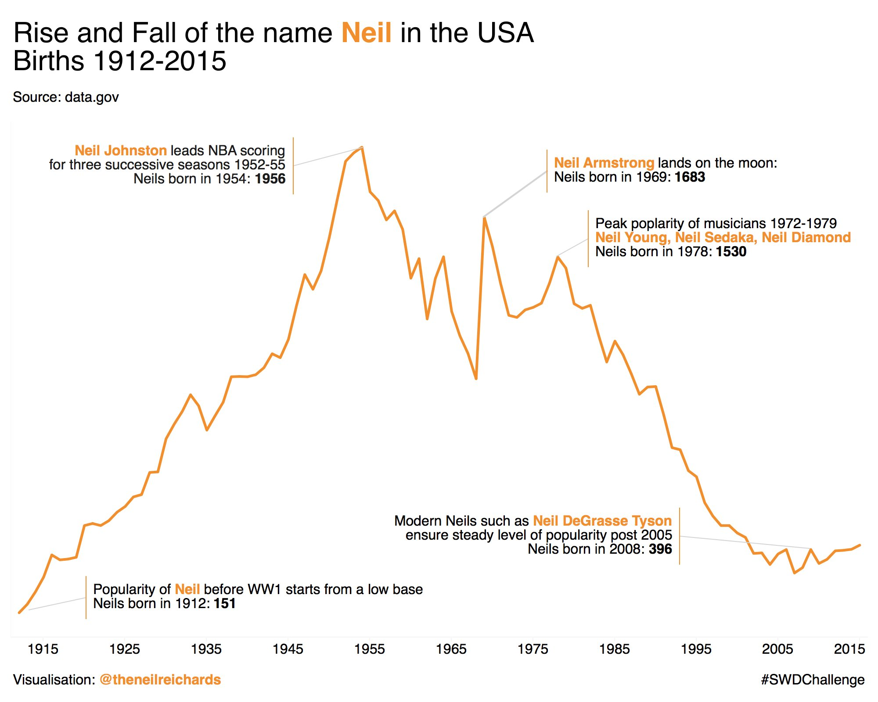
Explainers/annotations
Explainers allow readers to understand content quickly
  You can explain trends in the data
  Or how to interpret the graph

Slide 36
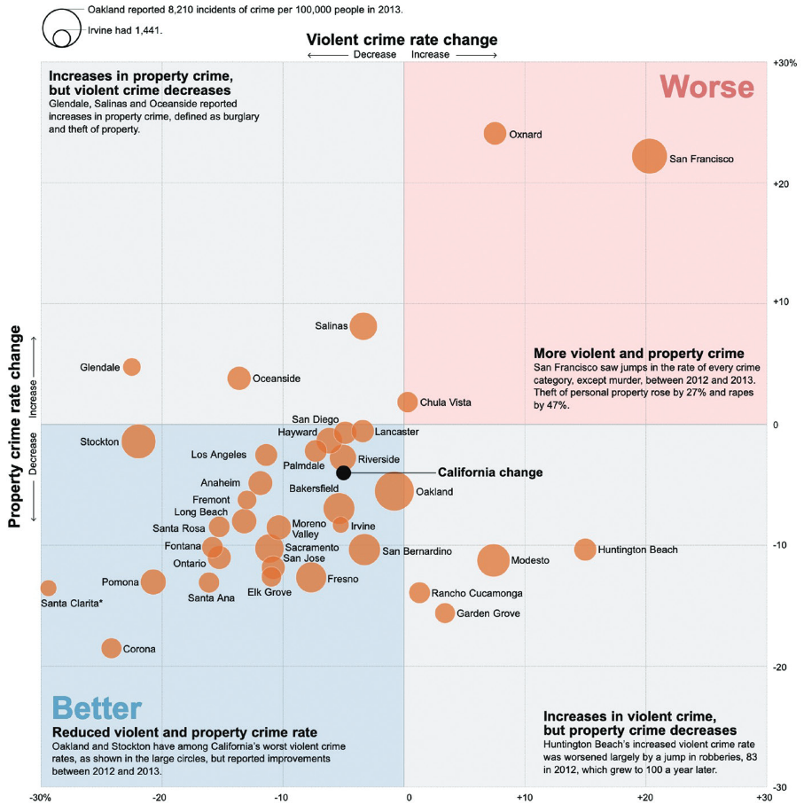
Explainers/annotations
Explainers allow readers to understand content quickly
  You can explain trends in the data
  Or how to interpret the graph

Slide 37
Your tools
Preliminary point: data-to-ink ratio
Text
Descriptive tables
Graphs
Dashboards
Regressions/ML results + interpretation tools

Slide 38
Descriptive tables
This is, of course, your bread and butter of data communication
Ideally, your tables should be understood even outside the context of your report/article (i.e. self-supporting), so mention the:
  Data source
  Sample
  Population
  Time or period of the data
  Geographical location
Avoid using acronyms defined elsewhere in the report/article, etc.

Slide 39


Tables design
Keep it light: border under header, bottom border, optional top border, no cell shading
  Table 1. Characteristics of French general practitioners, 2022 (national panel of general practitioners, N = 1000)
Variable¹ | N | %
Gender
Men | 597 | 59.7
Women | 403 | 40.3
Age
-50 | 363 | 36.3
50-59 | 417 | 41.7
60+ | 220 | 22.0
Variable¹ | N | %
Gender
Men | 597 | 59.7
Women | 403 | 40.3
Age
-50 | 363 | 36.3
50-59 | 417 | 41.7
60+ | 220 | 22.0
  Weighted data
  ¹Some other stuff
  Weighted data
  ¹Some other stuff
Notes:
Note: I did not put an active title. That was for a research paper (where this practice is not common).

Slide 40
Tables design
  Table 1. Characteristics of French general practitioners, 2022 (national panel of general practitioners, N = 1000)
  Numbers: right-aligned
  Text: left-aligned
Variable¹ | N | %
Gender
Men | 597 | 59.7
Women | 403 | 40.3
Age
-50 | 363 | 36.3
50-59 | 417 | 41.7
60+ | 220 | 22.0
  Put % in a header, avoid repetition
  Small indentations always look good
  White space to distinguish variable
  Weighted data
  ¹Some info
  1 or 2 decimals
Notes:
Note: I did not put an active title. That was for a research paper (where this practice is not common).

Slide 41
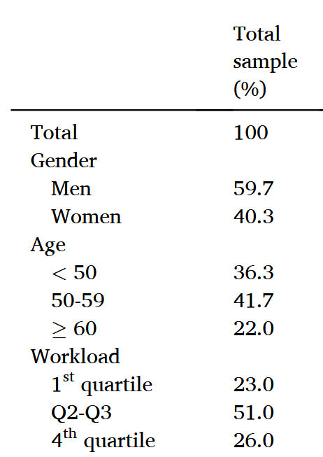
Categorical: 1-way
Most basic one: you analyse variables over the whole sample
It is not on this table, but you can also add the count (N)
Moving on…

Slide 42
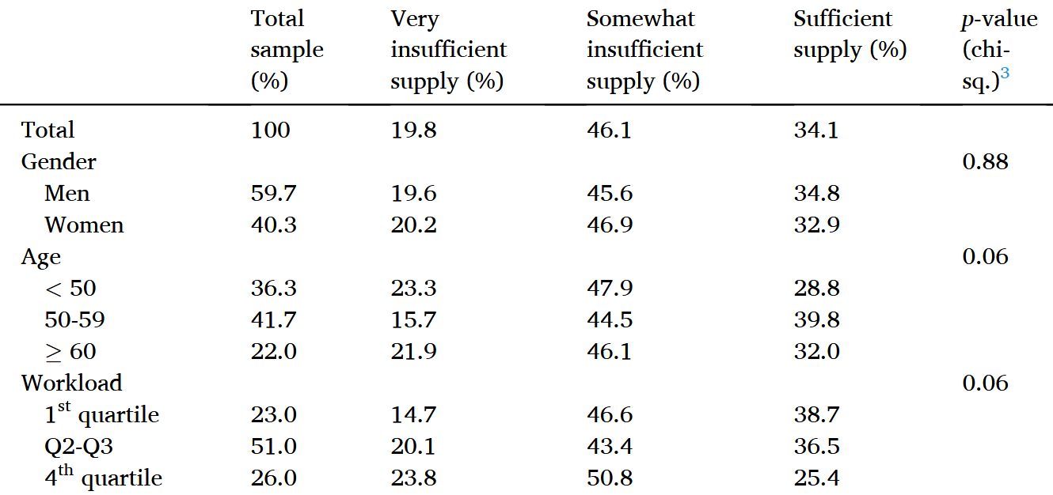
Categorical: 2-way (or cross-tabulation)
More interesting: now you compare two variables
First, you can introduce independence testing (i.e. see if the two variable are associated or not)
  Use chi-squared test
  Chi-squared test with Rao-Scott correction if you use weights
Then, choose which percentages to show: row, column, or cell

Slide 43
Row or column percentage? Row
It will depend on what you want to compare
If your column is a dependent variable, show row %
Here, we want to compare smokers with non-smokers (how more likely they are to get lung cancer): 38.2% vs. 19.6%
 | Lung cancer
Smoker | Yes (row %) | No (row %)
Yes | 38.2 | 61.8
No | 19.6 | 80.4

Slide 44
Row or column percentage? Col
If your column is an explanatory variable, or two or more groups you would like to compare, use column percentages
Here, we want to compare three profiles of people: the first group is mostly younger people, the second tend to have more middle-aged people than others, the last mainly older people.
 | Profile
Age | A (col. %) | B (col. %) | C (col. %)
-50 | 59.4 | 49.4 | 37.4
50-60 | 20.1 | 31.9 | 22.8
60+ | 20.5 | 18.2 | 39.8

Slide 45
Comparisons
You have this table:
You want to answer this question: “How much more likely are smokers to get lung cancer compared to non-smokers?”
What do you do?
 | Lung cancer
Smoker | Yes (row %) | No (row %)
Yes | 38.2 | 61.8
No | 19.6 | 80.4

Slide 46
Odds ratios (ORs)
In a logistic regression
 | Dependant variable Lung cancer
Explanatory variables | Odds ratio | 95% CI
Smoker (ref. No)
Yes | 2.53*** | [2.34; 2.72]
What does the 2.53 mean?

Slide 47
Odds ratios (ORs)
In a contingency table
 | Lung cancer
Smoker | Yes (row %) | No (row %)
Yes | 38.2 | 61.8
No | 19.6 | 80.4
How do you calculate an OR here?

Slide 48
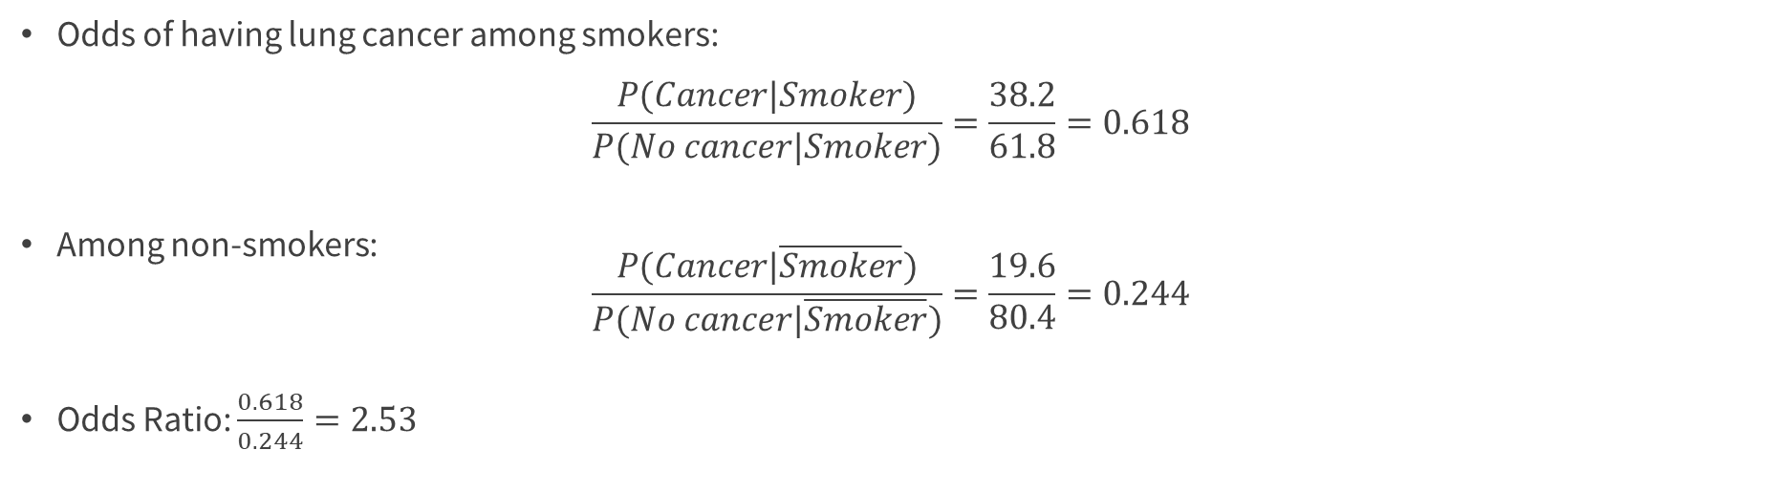
Odds ratios (ORs)
 | Lung cancer
Smoker | Yes (row %) | No (row %)
Yes | 38.2 | 61.8
No | 19.6 | 80.4
Odds of having lung cancer among smokers:
$$\frac{P(Cancer|Smoker)}{P(No cancer|Smoker)}=\frac{38.2}{61.8}=0.618$$
Among non-smokers:
$\frac{P(Cancer|\overline{Smoker})}{P(No cancer|\overline{Smoker})}=\frac{19.6}{80.4}=0.244$
Odds Ratio: $\frac{0.618}{0.244}=2.53$

Slide 49
Don’t mistake ORs for RRs
Most people mistakenly interpret odds ratios as risk ratios!
  In a logistic regression, for example, some would say “smokers are 2.5 times as likely to get lung cancer than non-smokers”, or “the probability of getting lung cancer among smokers increases by 150% compared to non-smokers”. This is false.
  Correct: “the odds of getting lung cancer among smokers is 2.5 times the odds of getting lung cancer among non-smokers” (which is… hard to understand)

Slide 50
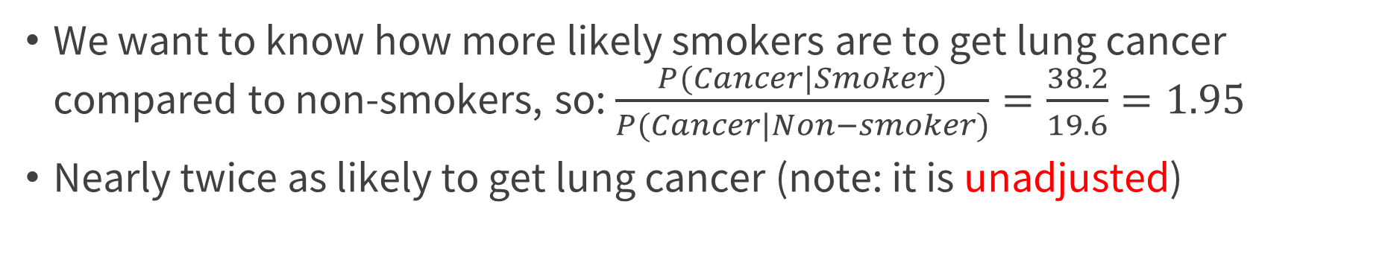
Risk ratios (RRs)
In a contingency table, RRs provide an intuitive way to measure the association between two variables
 | Lung cancer
Smoker | Yes (row %) | No (row %)
Yes | 38.2 | 61.8
No | 19.6 | 80.4
We want to know how more likely smokers are to get lung cancer compared to non-smokers, so: $\frac{P(Cancer|Smoker)}{P(Cancer|Non−smoker)}=\frac{38.2}{19.6}=1.95$
Nearly twice as likely to get lung cancer (note: it is unadjusted)

Slide 51
Don’t mistake ORs for RRs
Whenever possible, show risk ratios instead of odds ratios
Why do we use odds ratios?
  In some specific types of studies, we can only estimate ORs
  RRs are hard to estimate: they can be estimated with a log binomial regression… which very often fails to converge
  Logistic regression (which yields ORs) behave a lot more nicely
Still, there is a trick to obtain RRs (we’ll see that later)

Slide 52
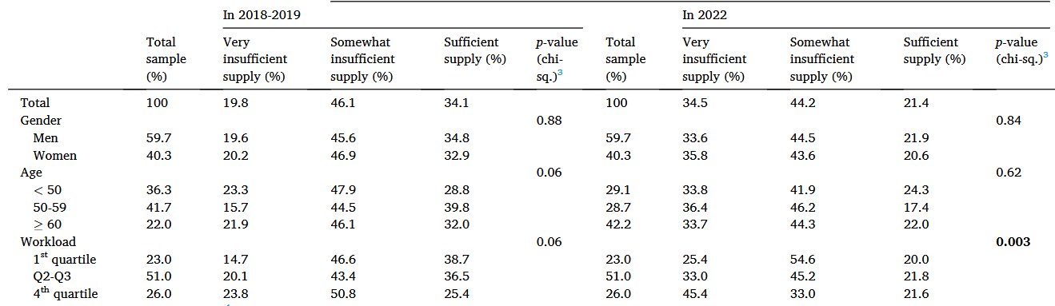
Categorical: 3-way
This exists… but it’s hard to understand
  You could do theoretically do n-way contingency tables, but they might be too complicated to understand quickly
Notes:
Only time I’ve done a three-way table was for this paper. It was to compare to cross-tabulations over time.

Slide 53
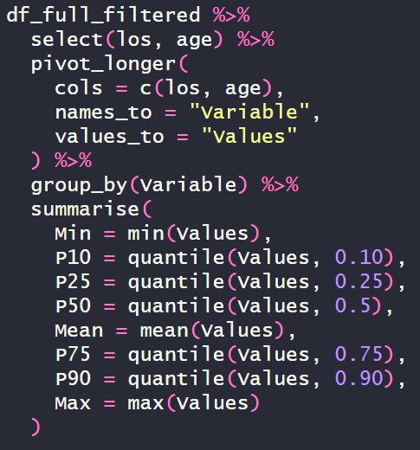
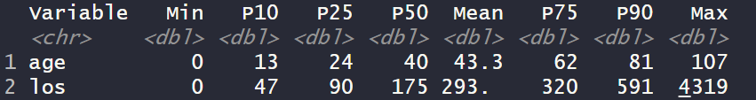
Continuous variable distribution
I use the following code to create tables for the distribution of cont. vars.
  You could make a function out of it (I never did because I am lazy)
“los” and “age” are continuous variables in my dataframe
Replace these names with yours
Rewrite and execute this function step by step to understand what happens

Slide 54
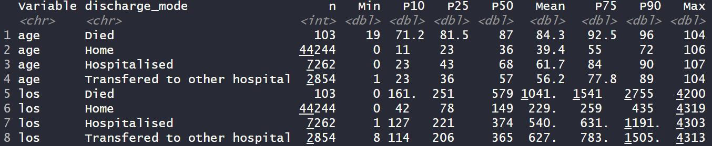
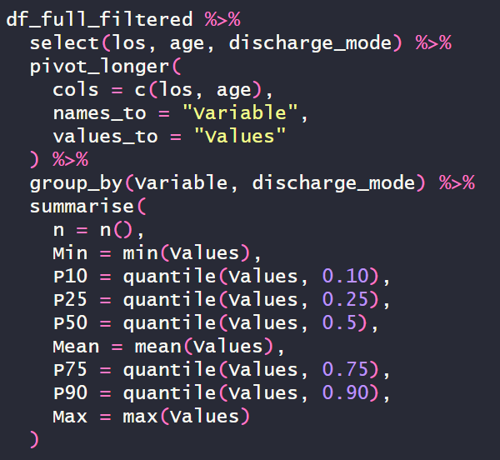
Continuous X Categorical
Easy to modify to include a categorical variable: just include it in the select and the group_by

Slide 55
Continuous X categorical
If you have a lot of continuous variables to analyse, a table will be quicker to read, whereas with graphs you would need to do one graph for each variable
Still, look at their distribution graphically (histogram, density plot, violin plot…) to understand how they behave
  You can just show plots for the most interesting ones

Slide 56
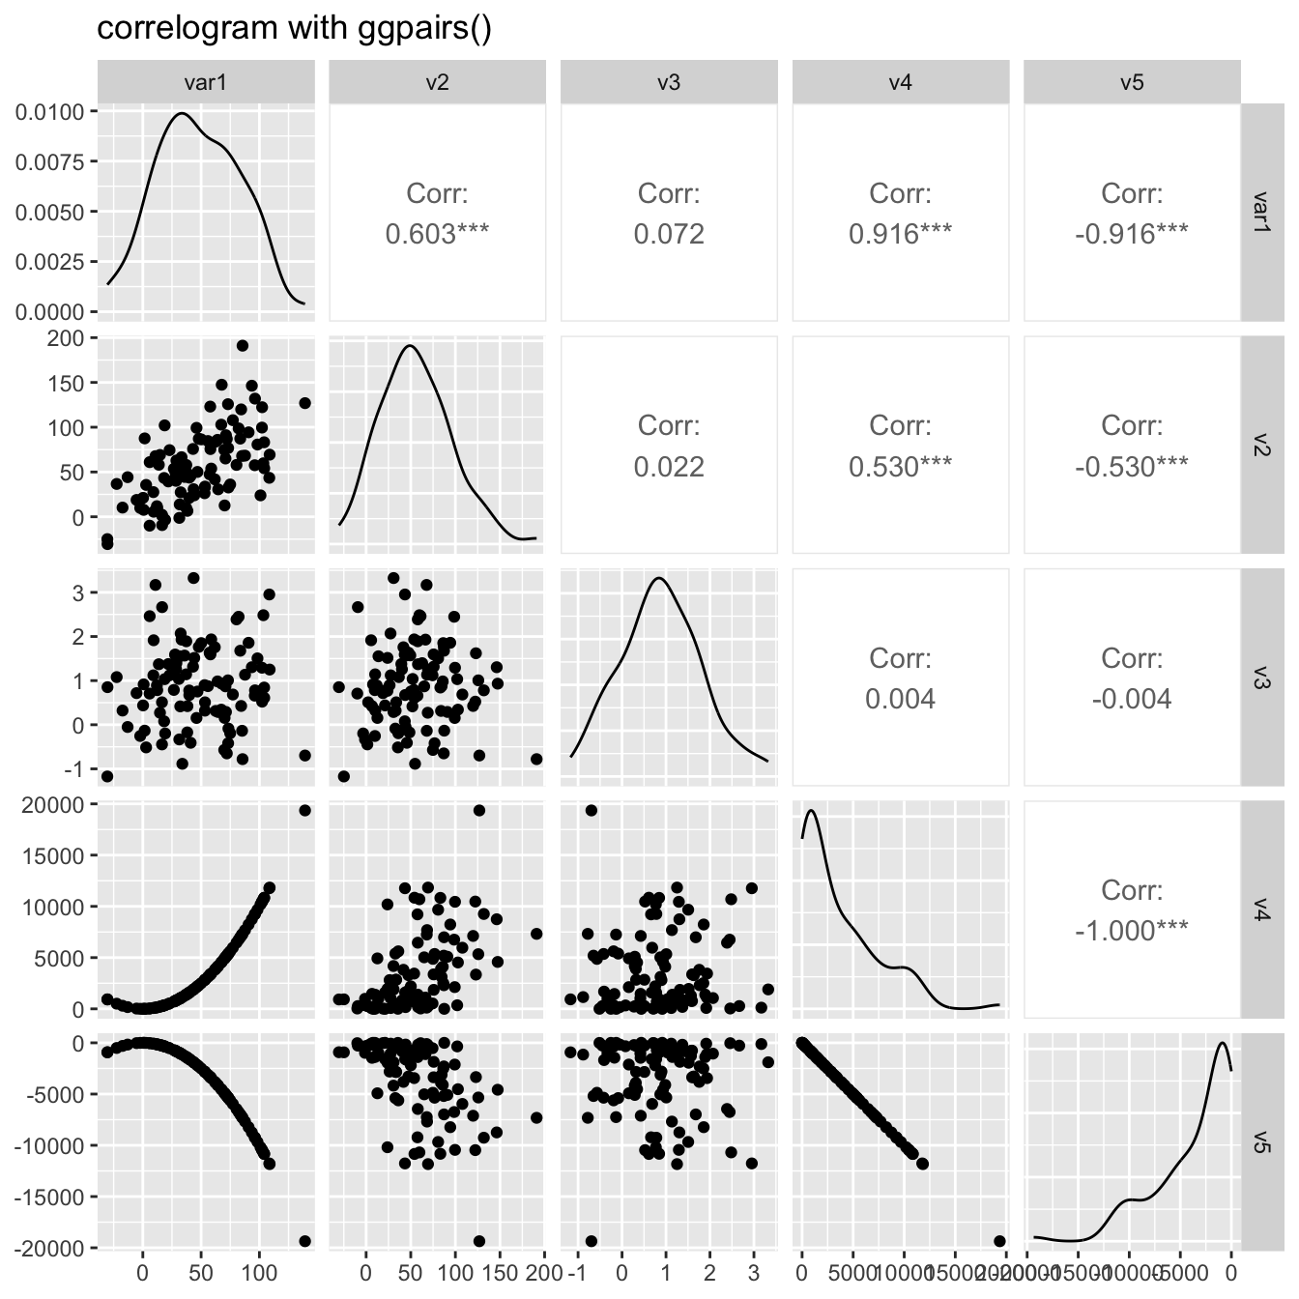
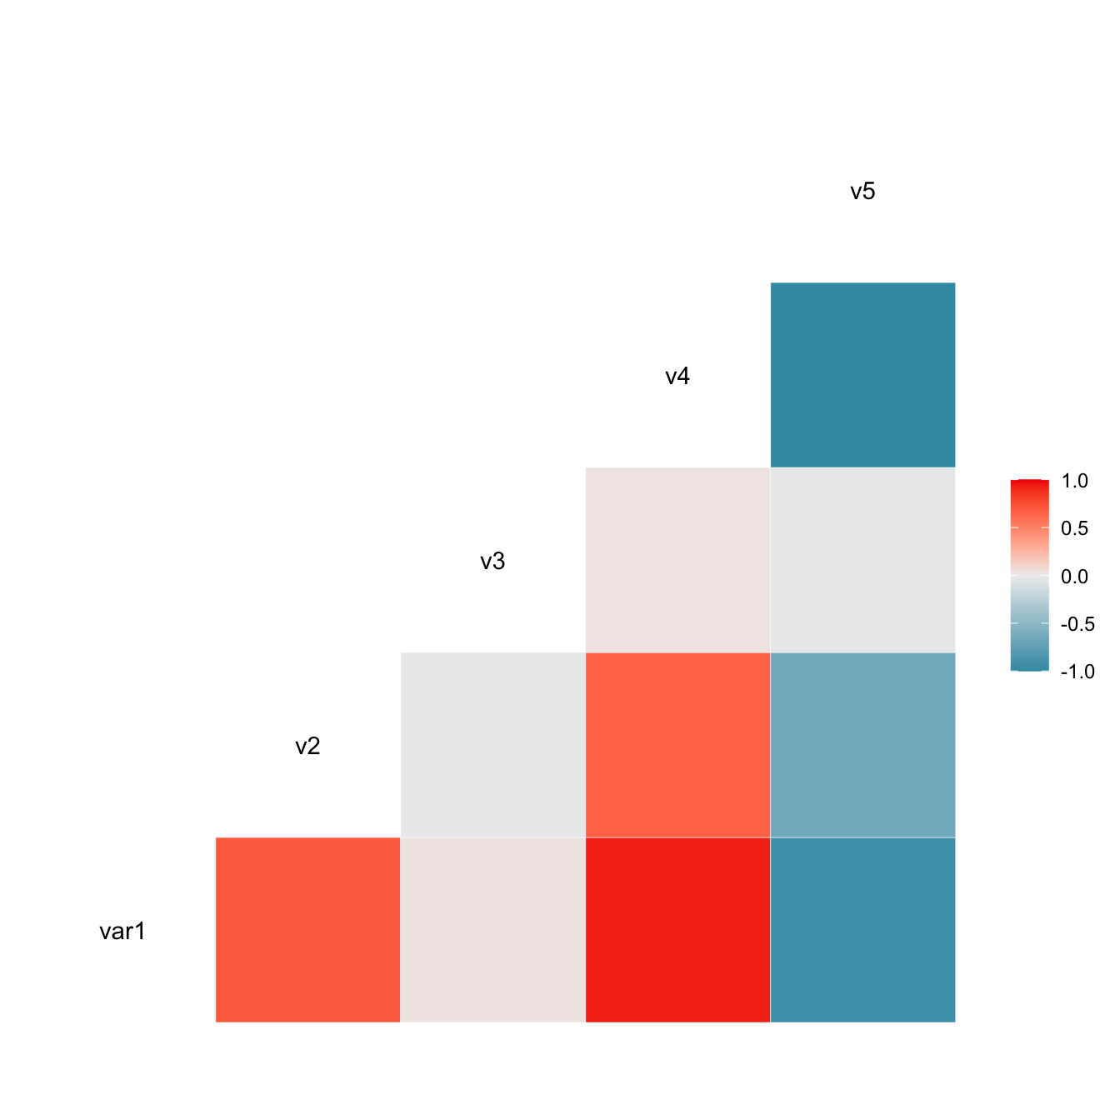
Continuous X continuous
Use correlations (Pearson, Spearman…), with the corr() function
Use ggcorr() and ggpairs() from the GGally package

Slide 57
Tabyl
Want to make a contingency table really quick on R?
  There is the table() function. Don’t use it.
  tabyl() from the janitor package is better.
Syntax:
  df %>%
  tabyl(your_variable)
You can include up to 3 variables at once

Slide 58
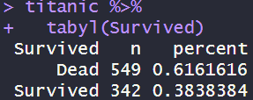
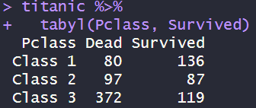
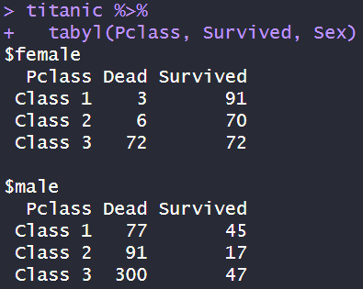
Tabyl - Example
1-way
2-way
3-way

Slide 59
Tabyl – Adorns
Main feature of tabyl is the adorn_ functions
  adorn_totals() adds rows and/or column totals
  adorn_percentages() adds row/col/cell percentages
  adorn_pct_formatting() controls the number of decimals (+ adds “%”)
  adorn_rounding() does… rounding
  adorn_ns() adds counts
  adorn_title() adds variable titles

Slide 60
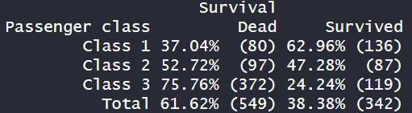
Tabyl – Adorns example
titanic %>%
tabyl(Pclass, Survived) %>%
adorn_totals() %>%
adorn_percentages("row") %>%
adorn_pct_formatting(2) %>%
adorn_ns() %>%
adorn_title("Passenger class", "Survival", placement = "top")

Slide 61
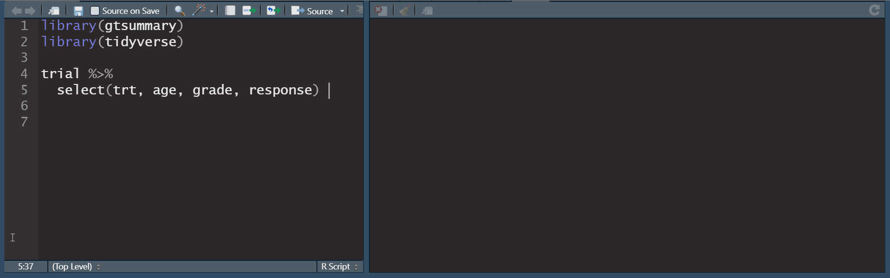
Exporting your tables (1)
CSV file is the quickest
  write_csv() or write_excel_csv() if you want to open it using Excel; it’s low size and universally readable
For automatically formatted tables
  There is the gtsummary package, that creates tables automatically
Notes:
Gtsummary outputs: latex tables, html, pdf, Word…

Slide 62
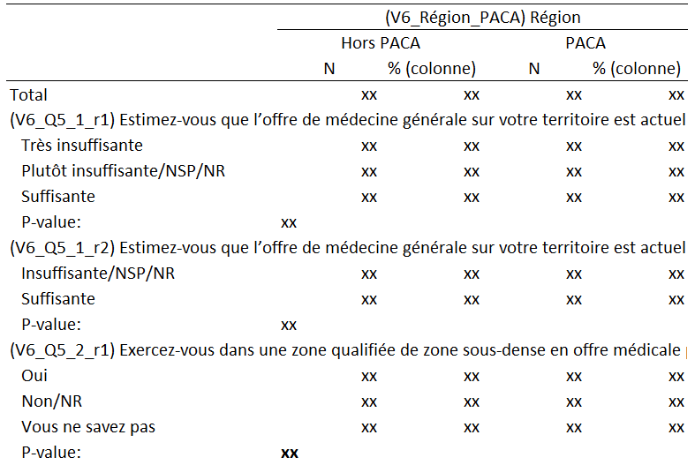
Exporting your tables (2)
I don’t use gtsummary because unfortunately we live in a world where most people use Excel
  And gtsummary does not export .xlsx files
So I use openxlsx
I have my own package that uses openxlsx, which automates formatting tables like these, with any variables I want
(Data is censored)

Slide 63
Openxlsx
Table creation is a very time consuming task; this should be the first thing you automate
With tabyl, Openxlsx is flexible enough to allow you to:
  Export one or multiple tables on the same Excel sheet, or different Excel sheets or files
  Format these tables to include, for example : sample size, a title, footer, borders, variable labels and values (for categorical variables)…
With some creativity, you can automate all your table creation process with just a function
  I do this on my package, if you want some inspiration: https://github.com/Dscronias/ds.reporting/tree/main/R

Slide 64
Your tools
Preliminary point: data-to-ink ratio
Text
Descriptive tables
Graphs
Dashboards
Regressions/ML results + interpretation tools

Slide 65
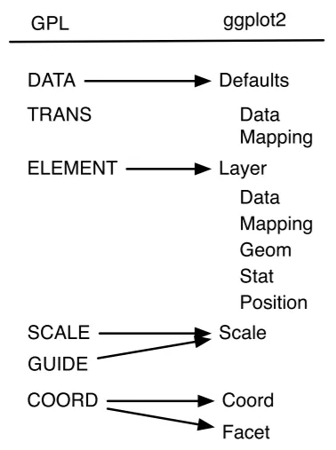
Graphs
Of course. A classic.
You probably already know how to use ggplot2
  Book here: https://ggplot2-book.org/ (it’s a WIP)
  The big alternative is plotly (I will talk about it)
    I read plotly for R is slowly getting retired (not 100% sure)
    A viable alternative is ggiraph
Check r-graph-gallery for inspiration and code
GGplot is based on a theoretical book called Grammar of Graphics by Leland Wilkinson
  So, GG stands for Grammar of Graphics
  It’s just a framework (see on the right) on which you build data viz, this book is not a required reading

Slide 66
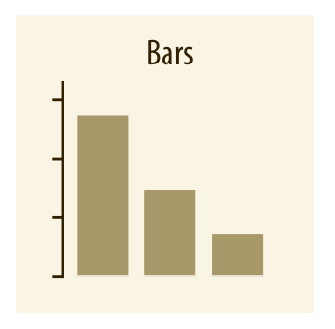
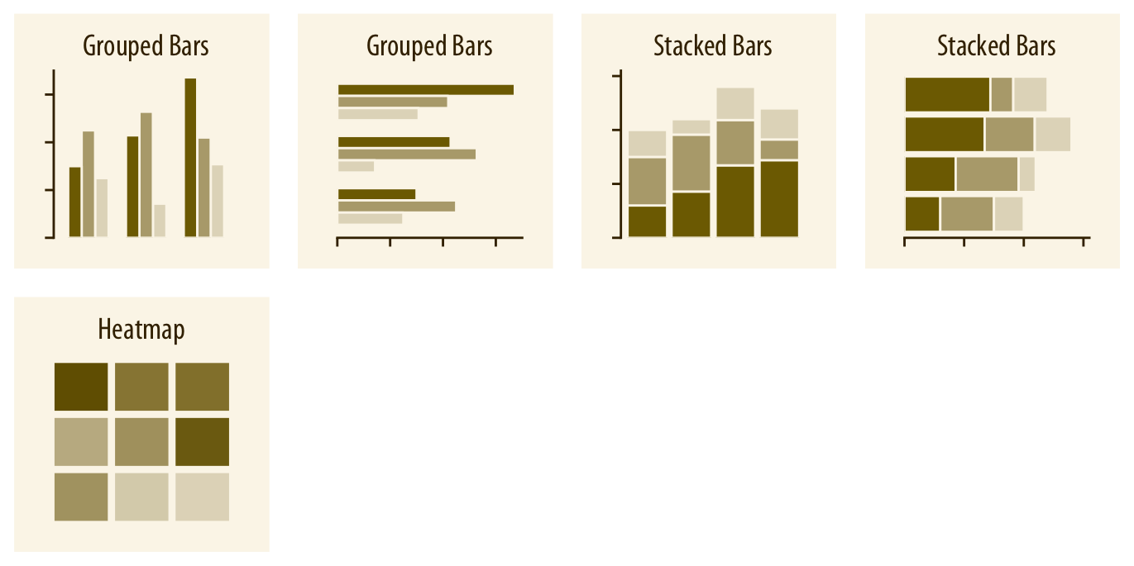
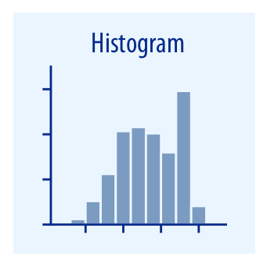
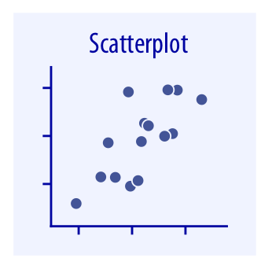
Types of visualisation
“Types” of visualisation are the various types of plots that you can do (representing amounts, distributions, %, etc.)
You know most already, so I won’t go over it:
  Again, inspiration here: r-graph-gallery
  Overview here: directory of visualisations
  In ggplot, these are called geom (geometrical objects)

Slide 67
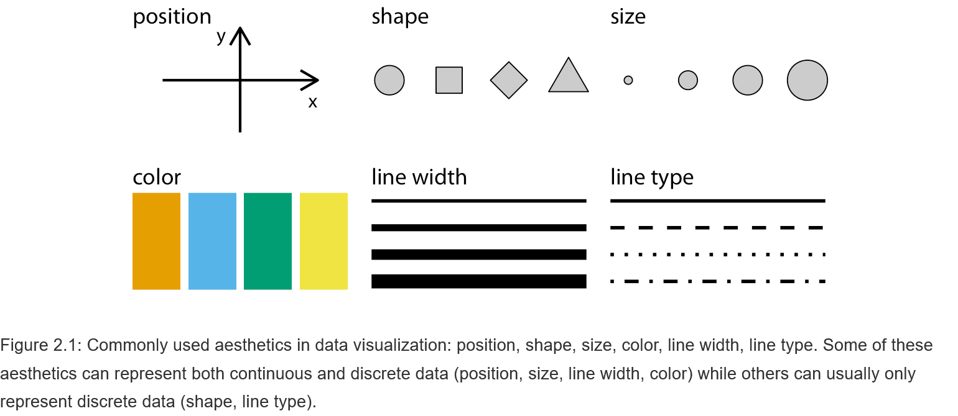
Aesthetics of graphs
+ opacity
+ fill
Fill = colour inside a geometric shape
Color = color bordering a geometric shape
These are the things you define here:
ggplot(aes(x = …, y = …, colour = …, size = …))
Notes:
The aesthetics define how you map (or « translate ») your data to visual elements

Slide 68
Stacking aesthetics
Just with these elements, I can represent 4 different variables here (+ additional information)
Watch out: compose your graph such that there is not an overload of information!

Slide 69
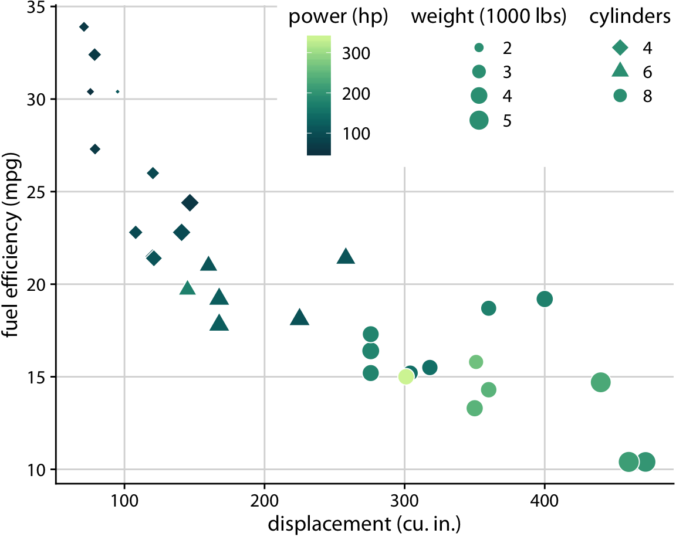
Stacking aesthetics
Typically here: this is still readable
But there is a lot of information
You will need guide the viewer as to what to take from this graph

Slide 70
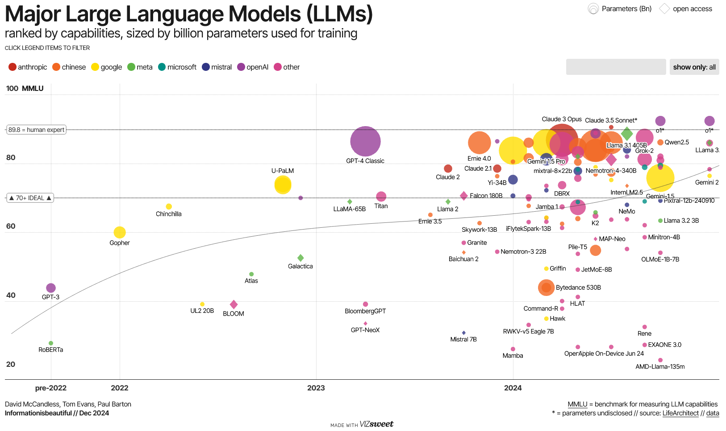
Try to experiment
Notes:
Your graph doesn’t end with just the aesthetic and a geom. Play with the theme, check if you can erase some ink without losing interpretability, think about making your graph interactive, add annotations, modify it by hand…
The most memorable graphs are those that don’t look like the default template of ggplot and Excel (and the best way to get good graphs is also to reuse other people’s ideas (: ).

Slide 71
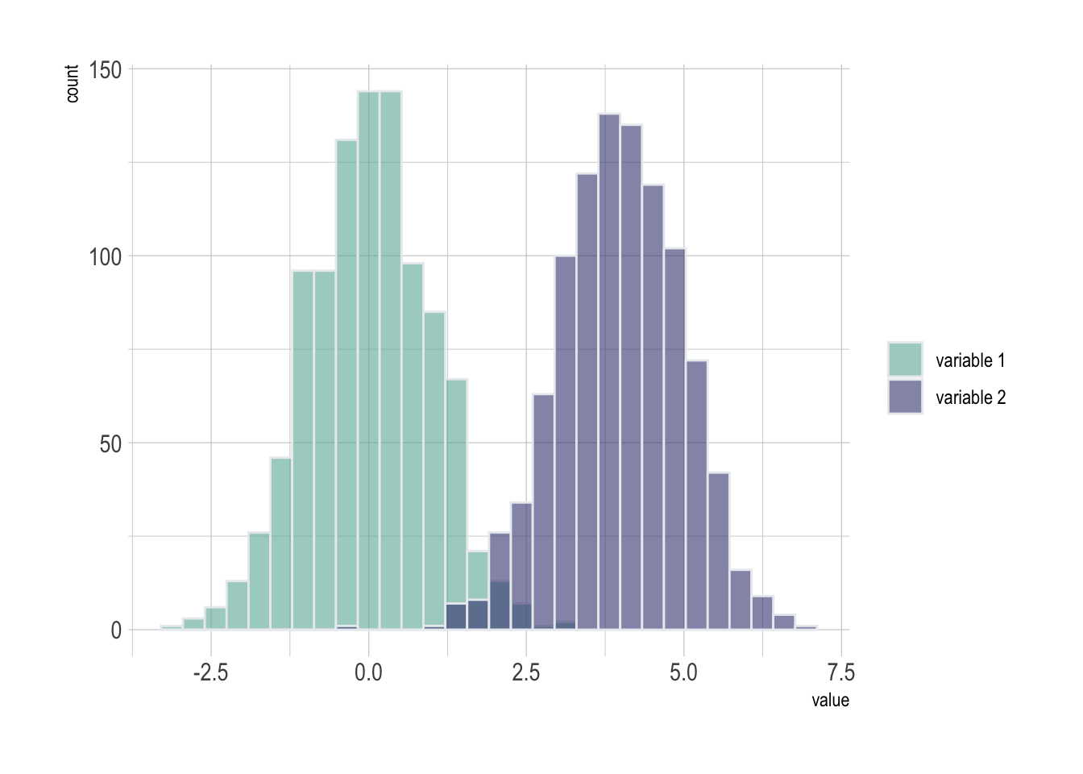
Colours
Colour will be your most powerful tool to convey meaning
At its core, you use it to distinguish between:
  Continuous values of a variable
  Discrete values of a variable
You need to think about your colour choice however, you can’t use anything you’d like however you want

Slide 72
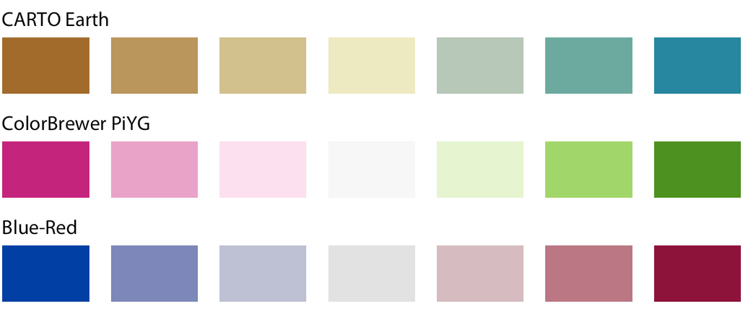
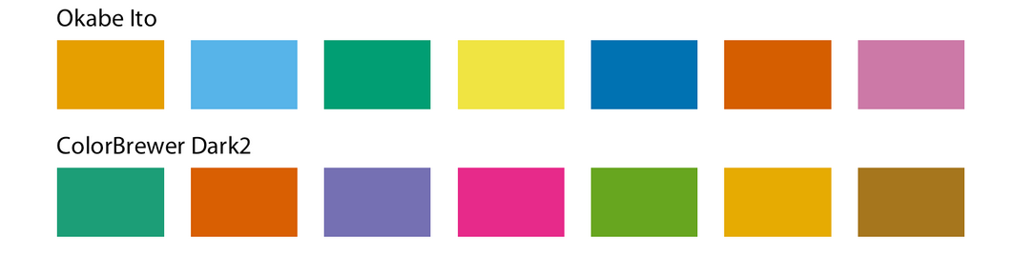
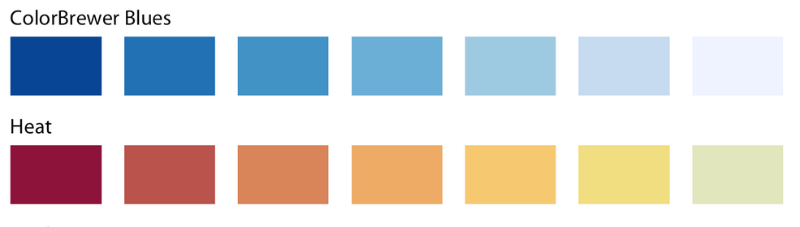
Three types of colour scales
Categorical
Diverging
Don’t mix them up!
Sequential

Slide 73
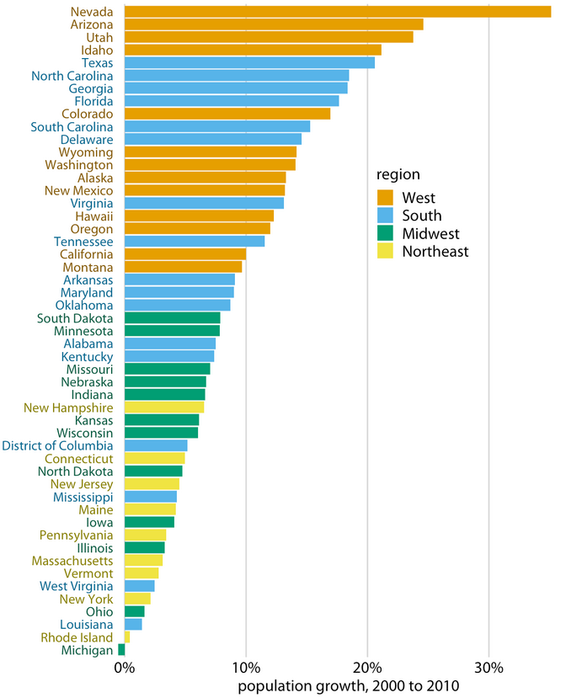
Categorical
Categorical scales are used to represent discrete/categorical variables with few values (less than a dozen)
These colours have no relation to one another, except these are very different

Slide 74

Categorical
This is what a categorical scale looks like on continuous data
Typically what you should not do

Slide 75

Sequential
Use it to represent a continuous variable which can only be positive or negative.
Notice the colours are a gradient (a smooth transition between two colour)
Richer

Slide 76

Sequential
Typically one hue (one shade), but can be multi-hue (two shades max)
Higher values are: more saturated (more intense shade), darker
Lower values are: less saturated (i.e. tends towards grey), lighter
This is a representation model of colour
You might know RGB (red green blue) already
Richer

Slide 77

Diverging
Variables with “opposing” end points (e.g. positive/negative)
Endpoints (very high/low values) are: more saturated, darker
Middle values tends toward grey (i.e. more or less neutral)
  Here this scale is a bit too saturated at the midpoint (possibly for the map to be readable)
More non-white
More white
Notes:
This

Slide 78

Colour choice convey cultural meaning
Be mindful of your choices:
Red/orange for negative outcomes
Blue/green for positive ones
Avoid stereotypes

Slide 79

Colour choice convey cultural meaning
Be mindful of your choices:
Use more saturated colours for “stronger” outcomes

Slide 80





Colour blindness
As you know, not everybody sees all colours (~8% men, 0.5% women)
Trichromacy
Green blind
Red blind
Blue blind
(extremely rare)
Monochromacy

Slide 81




In graphs

Slide 82

In graphs
The problem is that people with colour blindness may not be able to distinguish between two colours in your graph!
  Your graph will be unreadable

Slide 83
Colour scales for colour blindness
Ideally, choose colour scales adapted for colour blind people: like viridis, ciridis, or magma
The goal is to still have a color palette that can still be read by people with colour blindness
  Though viridis is still not optimal for people with blue blindness (deep blues look like a highly desaturated red)

Slide 84



Colour scales for colour blindness
For categorical scales: Okabe Ito
The # are hexadecimals codes, they go from #000000 to #FFFFFF
  Digits 1&2: red channel (i.e. quantity of red)
  Digits 3&4: green channel
  Digits 5&6: blue channel
Total of 16,777,216 colours to choose from

Slide 85
Foreground/background contrast
Common mistake among people: they don’t check the contrast between text and background (here, contrast is too low)
Texte
Texte
Texte
Texte
Texte
Texte
Contrast checker: https://webaim.org/resources/contrastchecker/
Notes:
The solution can just be to change the text from white to black. If you want to overlap two different colours, check with a contrast checker.

Slide 86


Capturing attention
If you want your audience attention to focus somewhere, add contrast. Well known thing in the visual arts.
Focus on light (+ lines)
Colour contrast
Notes:
Caravaggio, Calling of Saint Matthew
Klimt, Portrait of Adele Bloch-Bauer

Slide 87

Capturing attention
It’s an easy trick.
Colour contrast + shape
Grouping/lack of continuity
Notes:
Caravaggio, Calling of Saint Matthew

Slide 88
Capturing attention
Also works with TEXT
(keep it soft though)
Size contrast
Notes:
Caravaggio, Calling of Saint Matthew

Slide 89

In dataviz?
From “Storytelling with data”. Size + colour contrast.
Notes:
Caravaggio, Calling of Saint Matthew

Slide 90


In dataviz?
The colour trick will seem cheap after a while, but it works really well
Notes:
Caravaggio, Calling of Saint Matthew

Slide 91

In dataviz?
It works on many data visualisations
Notes:
Caravaggio, Calling of Saint Matthew

Slide 92
In dataviz?
Variable¹ | N | %
Gender
Men | 597 | 59.7
Women | 403 | 40.3
Age
-50 | 363 | 36.3
50-59 | 417 | 41.7
60+ | 220 | 22.0
On tables too
Notes:
Caravaggio, Calling of Saint Matthew

Slide 93

Last one I promise
“Storytelling with data” shows great graphs. Notice how each paragraph applies to the more saturated bars.
Notes:
Caravaggio, Calling of Saint Matthew

Slide 94

How to do it on your graphs
In a nutshell, modify “pre-attentive attributes”
In graphs, the easiest one to use will be colour
With text: colour and size
Be mindful: some of these attributes (e.g. size) may be used to represent a variable
Also, most of this must be done by manually…
Use sparingly
Notes:
Caravaggio, Calling of Saint Matthew

Slide 95

Colour scales for highlighting
You mostly saw shades of grey to represent “less interesting” data
You can use highly desaturated colours/pastel instead
The darker, more saturated shades are seen as highlights
Notes:
Caravaggio, Calling of Saint Matthew

Slide 96

Big data graphs
This is a typical graph in big data (there are 2 million data points)
  It takes ages to render
  It is unreadable
  You can’t understand if there is an association or not
What can you do?

Slide 97

Big data graphs – Opacity
The quickest is to reduce the opacity of the points
  E.g. : geom_point(alpha = 0.001)
  Each points will be “more transparent”
  But the overlapping ones will become more
You may need to fine-tune the alpha coefficient depending on how much data there is

Slide 98

Big data graphs – 1D binning
Create percentiles of one of the axis (use ntile())
  Calculate the mean of the other axis for each percentile (use group_by() + summarise())
The estimates might be less precise at extreme percentiles
  Also you can compute confidence interval
Noise I think?
Notes:
Disadvantage: you lose of the absolute values of x

Slide 99

Big data graphs – 2D densities
Automatically divides the plane in n bins (i.e. rectangles) and count the number of points in that bin
100 bins here
It’s a clearer than using opacity (but uglier)
Notes:
I find visualising two continuous variables with millions of data points to be very messy. And here, 2 millions data points is far from big data territory. You will find that you have a lot of noise that makes graphical interpretation hard.

Slide 100

Graphs: static vs. interactive
Let’s introduce plotly (website)
This is an alternative graphing library to ggplot
The advantage: its graphs are interactive
  You can pan, move and zoom on the graph
  Hovering with the mouse over a data point can give information about it (position, group…), or additional information of your choosing.
The easiest way to use is to create a ggplot graph first, then to use the ggplotly() function on it.
  This will make the graph interactive

Slide 101
Graphs: static vs. interactive
Great in the context of interactive tools (e.g. dashboards)
Useless for written reports, and for most presentations
  You’re better off using ggplot, you will find more documentation and additional packages for it

Slide 102
3D plots
Plotly offers the possibility of creating 3D plots
Interactive examples here
Easy to do: you can specify a z variable in the plot_ly() function
It is hard to read though (because you must manipulate the cube), and of course because it must be interactive to be understood, this limits its usages
Maybe only consider a 3D graph when a 2D graph cannot give enough information

Slide 103
Exporting and modifying graphs
Packages and Excel are good and all, but sometimes you will want to modify a graph in such a way that it is not easily doable on Excel or your preferred statistical language
Two solutions:
  Give this task to someone else (e.g. graphic designer at your company), but this takes time and they will eventually hate doing all your dirty work
  Do it yourself

Slide 104
Exporting and modifying graphs
By the way, if you want good striking graphs like these, you will have to modify R outputs by hand

Slide 105

Two big kinds of image files
Good for pictures or digital painting.
Bad for graphs. Avoid.
For graphic design, graphs, document

Slide 106

Raster
You are already familiar with pictures (files ending in .jpg, .png, etc.)
An image has a resolution (a number of pixels)
If your image is low-res and you increase its size, it will look blurry
Ugly to look at

Slide 107

Can you upscale tables/graphs?
Upscaling means increasing the resolution (using AI, or other tools)
Avoid. It’s great for pictures, but upscaled texts looks uncanny.
Software: Upscayl (free, open source)

Slide 108

Vectors
Vector graphics, instead, are mathematical equations, lines and curves on a grid.
Resolution is not a problem; these can be as big as you wish and still look clean

Slide 109
Graphs: raster vs vector (2)
Vector graphics, instead, are mathematical equations, lines and curves on a grid.
Resolution is not a problem, these can be as big as you wish and still look clear

Slide 110
Graphs: raster vs vector (2)
Vector graphics, instead, are mathematical equations, lines and curves on a grid.
Resolution is not a problem, these can be as big as you wish and still look clear

Slide 111
Why you should use vectors for graphs
You don’t have to worry about resolution
  You can export the graph as an image in any resolution you want
Aligning elements is easy
Changing colours, line types, opacity, or other characteristics of geometrical objects is easy
You can group elements and layers for batch modifications/alignment
Your graph will still look clean and professional at a fraction of the time it would have taken you in Photoshop
However, don’t export huge scatter plots (with millions of point) in svg
  This will be very slow, and your editing software may crash when opening it
Notes:
Aligning: show it exists in PowerPoint

Slide 112




Image software
For raster:
  Adobe Photoshop is the best IF your company has it (don’t buy it)
  Else, GIMP is free and does the job (but is less good)
  Do yourself a favour and don’t use Paint
For vectors:
  Adobe Illustrator IF your company has it (again, don’t buy it)
  Inkscape is plenty enough for what you will need to do

Slide 113
Your tools
Preliminary point: data-to-ink ratio
Text
Descriptive tables
Graphs
Dashboards
Regressions/ML results + interpretation tools

Slide 114


Dashboards
A dashboard is an interactive tool you use for data visualization. Imagine a webpage on which you have/can do:
  Interactive tables for which you can select variables you want to show
  Interactive graphs and maps on which you can zoom, get tooltips when your cursor hovers a data point
  Filter the dataset on the fly
  Even let the user use a regression model for which they can choose covariates

Slide 115
Dashboard inspiration
Again, looking at other dashboard is how will you get inspired to try new things with your dataviz
  Here: https://shiny.posit.co/r/gallery/

Slide 116
Why dashboards? And when?
Entry cost can be high
  Intermediate level technical know-how if you code it: need to know specific R/Python packages, and ideally HTML/CSS (even better if you know Javascript)
  Time consuming to prepare
  If you choose to buy a dashboarding software, money might be the issue
But, it allows more exploratory approaches
  Clients/stakeholders/decision makers can look at the data themselves
  If they have questions, and your dashboard is flexible enough, you may answer their questions directly in the meeting with your tool
Usually, people love this
  Again: PEOPLE. LOVE. THIS.

Slide 117




The paid ones
Above: Tableau, PowerBI, QlikSense, Looker
  There are many, many others
There are free versions if you want to learn one of them
  DON’T PAY FOR THEM
  Maybe learn one, and if you work on others they will feel at least a bit intuitive
  To my knowledge, there is no “big one” that is used everywhere

Slide 118



The free, flexible ones (i.e. the good ones)
Above: Shiny (R), Streamlit (Python), Dash (Python)
  For R, virtually every dashboard is done using Shiny
  There are also others for Python: Shiny, Holoviz…
Python will offer more package variety: it’s more of a “general-purpose” language than R, and its been used in web development for a while (e.g. Django)

Slide 119

We will do some Shiny this afternoon
This is a package developed by RStudio (Posit PBC, now) since 2012
  There is a book about it (Mastering Shiny) by Hadley Wickham, a key person at Posit and one of the developers of the tidyverse
It’s a web framework: with it, you can create a web application
  It’s mainly known for dashboards, but it is somewhat versatile
  You could create a web application in which you do all your statistical modelling for example (it won’t be as good as programming this in R though)
  Gallery for inspiration: https://shiny.posit.co/r/gallery/
  There are add-ons that build upon it, I personally use bslib a lot
  https://nz-stefan.shinyapps.io/commute-explorer-2/
Notes:
Now, it is not a full fledged web framework, you won’t build complicated web applications with it. But it’s not like you are studying data science to be a web developer, so this will do.

Slide 120



Front-end and back-end
A Shiny application has two parts:
Front end
(User interface)
Back end
(server)
Notes:
So the front end is where you decide what the user sees, what he can do or modify or click on. You define the layout of the web application, the buttons, sliders, what visualisations you include…
The back end is where you decide what content populates each element in the front end. What goes inside each graph, table, what data each slider refers to, etc. etc.

Slide 121

Front-end - Layout
Navbar (top or bottom) ➔ Title/logo + pages
The navbar and sidebar are facultative
If you change want a single page, this is possible
Body ➔ You put your content there
Sidebar (left or right, or both) ➔ Usually settings, parameters

Slide 122

Front-end – Components
You can fill your pages with texts, headers, images, graphs, tables…
You also have the possibility of defining parameters (see sidebar), they will allow for reactivity
These are inputs
They take the form of sliders, buttons, drop down menus…
These are outputs
Usually tables and graphs

Slide 123
Front-end
Back-end
In the server side, we say what goes into each element defined in front-end. In table_1, we put a dataframe called df
output$table_1 <- renderDT({df})
This table here has an output id: table_1 (for example).
dataTableOutput(outputId = "table_1")

Slide 124
Reactivity
Back-end
In the server side, we can use the inputs to impose some conditions. For example, in table_1, if we wanted to only see values of speed below the value of slider_1.
We define a reactive object (it gets automatically updated when an input changes)
df_reactive <- reactive({
df %>% filter(x <= input$slider_1)
})
This input here has an input id: slider_1 (for example).
We then use this reactive object to populate the output element called table_1
output$table_1 <-
renderDT({df_reactive()})

Slide 125
Your tools
Preliminary point: data-to-ink ratio
Text
Descriptive tables
Graphs
Dashboards
Regressions/ML results + interpretation tools

Slide 126
The what and the why
We will distinguish two outputs from regression/ML models
  What? The predictions themselves
  Why? How the predictions were made
There may be situations where the why is not needed:
  If the process is known well, or is low stakes
Otherwise, it is preferable to understand the process which made the prediction:
  To better understand what happens, create knowledge
  To avoid undesirable bias

Slide 127
Black box/White box
We also typically distinguish between white boxes (interpretable) and black boxes (too hard to interpret) models
White boxes: generalised linear models, mixed models, decision trees…
  White boxes are not always easy to understand
  The more variables & interactions you have, the harder the interpretation
Black boxes: neural networks, Random Forest, gradient boosting…
  The problem is that there are too many coefficients for you to reasonably understand what happens
  This does not mean there is no way to interpret these results

Slide 128
The what
In R, with any model, you can use the predict() function to generate… predictions
  You can do that on the data you used to fit the model, or new raw data, or on counterfactual data you created yourself
The latter is interesting, we can use it to generate predictions for what-if scenarios (counterfactuals) and to generate predictions at fixed levels of variables
  E.g. what is the average probability of spending a night in an emergency service when one has a long-term illness?
  What would be the probability of being employed if everyone undertook some job programme?
I use the marginaleffects package for this

Slide 129
The why
With white box models, you can understand the why more or less easily by looking at coefficients
  You can organise that tidily in a regression table or in a dotplot
With black box models, it is more complicated
  You will have too many coefficients to interpret
  Fortunately, there exists model agnostic (i.e. works with any model) methods to understand your model better
  I use the Dalex package for this
    The package has a free book
    For a more general book on interpretation: Interpretable Machine Learning by Christoph Molnar
    Also, Tidy Modeling with R is a great, up-to-date book with the latest shiny packages for doing modelling, and has a chapter on explainability: https://www.tmwr.org/

Slide 130


The regression table
The same kind of rules apply to regression tables as for descriptive tables (so refer to this)
However, the standard R output for regression is terrible
  So use the tidy() function from broom instead
<<<
This is not even a dataframe
Better

Slide 131
Which columns to keep?
I might make enemies there:
  Term and estimate, you obviously keep
  Std. error will be too complicated for most people to understand
  T-statistic, nobody understands this (though you can use it to measure variable contribution to a model)
  P-values… are bad

Slide 132

Confidence intervals
Confidence interval at a given confidence level (here 95%): we are 95% confident the estimate lies between [conf.low; conf.high]
Here’s why I think p-values are bad and you should use confidence intervals:
  People don’t understand what a p-value means
  People are fixated on getting a p-value < 0.05 and don’t understand what a p-value of 0.048 might mean
  I find this system of *** (< 0.001), ** (< 0.01), * (< 0.05) too arbitrary
  Confidence intervals tell you about the uncertainty around your parameter
  Confidence intervals tell you about its possible magnitudes

Slide 133
Proposed regression results design
  Table 1. Factors associated with miles per gallon consumed in cars, Year, linear regression model (mpg dataset, N = XX)
Variable¹ | Coef. |  | [CI 95%]
Intercept | 34,87 |  | [29,82; 39,93]
WT | -3,24 |  | [-4,96; -1,52]
HP | -0,03 |  | [-0,06; -0,01]
Gear (ref. 3)
4 | 1,26 |  | [-1,36; 3,89]
5 | 1,87 |  | [-1,78; 5,53]
Use the same rules as for descriptive tables
Harder to format (in my opinion)
  You can use subheaders to distinguish between families of variables
  Keep two decimals, or one significant decimal
  Coefficients right-aligned, CI left-aligned (add an empty column between the two to adjust white space)
  Problem: the semi-colon (;) are not aligned
  I put significant results in bold
Add new columns if multiple models
  CI: confidence interval.
  ¹Some other stuff

Slide 134

Alternative: dot plots
Some results may be hard to see, depending on your coefficients
A solution could be to get standardised coefficients

Slide 135
Extracting further insights from your models
Most people stop at a regression table
But there is other knowledge you can extract from your all of your models:
  Predictions for specific observations
  Counterfactual scenarios
  Comparisons and contrasts
  Marginal effects of variables at specific values of covariates
  Variable importance…
These methods are less commonly used (except variable importance), so be sure to take some time to explain them

Slide 136
HIV detection dataset example
Dataset of 2K observations, four variables:
  Outcome: whether the participant travelled to a test center to learn their HIV status (binary variable)
  Agecat: <18, 18 to 35, >35
  Incentive: whether the participant received a financial incentive to get tested (binary variable)
  Distance: in km from the village to the test center
We fit a logistic model:
  glm(
  outcome ~ incentive + agecat + distance,
  data = hiv,
  family = binomial
  )

Slide 137

Logistic regression results
Outcome (Y): going to a center to get tested for HIV
Agecat variable reference: <18
How do you interpret the odds ratios?
Incentive: odds of getting tested when you received an incentive are 7.33 times the odds of getting tested when you don’t receive an incentive
Agecat: same thing, but you compare each line to people under 18
Distance: for each km, odds etc. get 15% lower

Slide 138
Risk ratios in regressions
Earlier I showed you the difference between risk ratios and odds ratios.
You can approximate risks ratios with a specific regression: the robust poisson regression
  The idea comes from this paper by Zou
Keep it mind this method is somewhat… controversial
  🚩The predictions are useless: a poisson model yields counts, which can be > 1 (a probability cannot be > 1)
  🚩You won’t be able to use goodness-of-fit tests because of this

Slide 139
Robust poisson regression
First, your dependent must take only two values: 0 and 1 (it must be numeric)
  This won’t work if it takes more than two values
  This MUST be 0 and 1. Not -1 and 0, not 0 and 2, not 1 and 2. 0 and 1.
Fit a glm with the following family:
  glm(y ~ x, family = poisson(link = log), data = df)
Keep the estimates, but correct the standard errors with using lmtest and sandwich packages
  coeftest(results, vcov = sandwich)

Slide 140

New regression results
Notice the huge difference in interpretation between ORs and RRs!
Especially incentive. The risk ratios are a lot easier to interpret.

Slide 141

Enter marginaleffects
Marginaleffects is a package to calculate marginal effects ($δY/δX$) and adjusted predictions at fixed levels of variables
  Calculating marginal effects is very useful to understand non-linear models (e.g. logistic regression) for example
This package can be used for Machine Learning models, but it is less common, and I will show you another package (Dalex)
Website with guide here: https://marginaleffects.com/

Slide 142

Individual fitted predictions
We want to know how the incentive modify the probability of getting tested among people under 18 (at the average of other covariates)
This creates two fictional observations
  We allow incentive to vary between 0 and 1
  But we fix age and distance
  Model refers to the logistic model we fitted earlier

Slide 143

Individual fitted predictions
Using the predictions() function, we find the probabilities of getting tested for these two fictional individuals: 31% if they don’t have a financial incentive, 77% otherwise

Slide 144

Counterfactual scenarios
What if everybody had an incentive? If everybody did not have an incentive?
  Here, we get into counterfactual scenarios: we create the same dataset twice, but we just change the incentive parameter

Slide 145


Counterfactual scenarios
The idea then is to compute the average estimate across the values of incentive
  Faster way of doing this is to use avg_predictions()
If everyone had received the incentive, the average predicted probability of getting tested would be ~80%
  34% if nobody received an incentive

Slide 146


Counterfactual comparisons
Same thing as before: two counterfactual scenarios, but we compute the difference in probability between for two scenarios for each individual
“difference”: difference in probability
On average, receiving a financial incentive increases the probability of getting tested by 0.45

Slide 147



Counterfactual comparisons
You can get RRs too
“lnratioavg”
Results and interpretation are nearly identical to what you get with the robust poisson regression

Slide 148

Conditional predictions
How does distance affect probability of getting tested? Across values of the incentive?
  Idea: fix other covariates at representative values (mode, mean) and compute predictions

Slide 149
Interpreting ML results: a warning
Machine Learning often use black box models: they can model complex interactions in your data, but are hard to interpret
Models exist to interpret what your model is doing
Be careful with this:
  Stop Explaining Black Box Machine Learning Models for High Stakes Decisions and Use

Slide 150

Interpreting ML results
Let’s switch to a machine learning model
This is a Random Forest trained on the full data
  It’s technically a probability forest: it outputs probabilities instead of a class
Ideally, you would do that after doing K-fold cross-validation to find the best parameters and to find how your model generalise, etc. etc.
  But it’s not the point here

Slide 151

Dalex
To initialise Dalex, you need to create an explainer
Basically a standardised object which contains:
  Your fitted model
  Your matrix of regressors (X)
  Your vector of responses (Y)
This works with any model (not just ML)

Slide 152


Break-down plots
A break-down plot tells you, for an individual datapoint, how each variable contributed to the prediction
This starts from the intercept (mean of Y)
Then, by decreasing importance of each variable, we see how the prediction varies
Note: at the end you get the prediction, not the true outcome (which can be different)
Avg. prediction
Avg. Prediction for incentive = 0
Avg. Prediction for incentive = 0 & distance = 1.435
Etc.

Slide 153

Break-down plots
Example on a more complicated model (from the Titanic dataset)

Slide 154

Partial dependance plots
Similar intuition to conditional predictions, but more complex, and we don’t fix other variables levels:
  Take a sample (this method is computationally intensive)
  For each individual, vary one regressor by a tiny amount many times and predict Y
  Calculate an average profile
Code for a custom plot
You could just write plot(pdp) instead

Slide 155

Partial dependance plots
Each grey line is an individual
The blue line is the average profile
Watch out: notice there is heterogeneity in the predictions
Here we clearly distinguish people with an incentive, and without

Slide 156

Partial dependance plots
You can create PDP by group

Slide 157

Partial dependance plots
Logistic regression
Random forest
Trends are similar, but logistic regression tends to extrapolate more at extreme values of distance
Lot of noise with RF

Slide 158
Variable importance
Which variables are the most important to predict what we would like to predict? We will use permutation
  Take your full model, look at its error (e.g. RMSE)
  Successively, for each of your variables: scramble it randomly, compute predictions again, and look at the error
  The bigger the error after data permutation, the more important the variable
  Do permutation multiple times for each variable to get an idea of the uncertainty surrounding its importance

Slide 159

Variable importance

Slide 160
Dalex & marginaleffects
There is a lot more these packages can do and that are explained in their respective books/websites
In the end what you show will depend on the story you want to tell with your data

